Slide 1

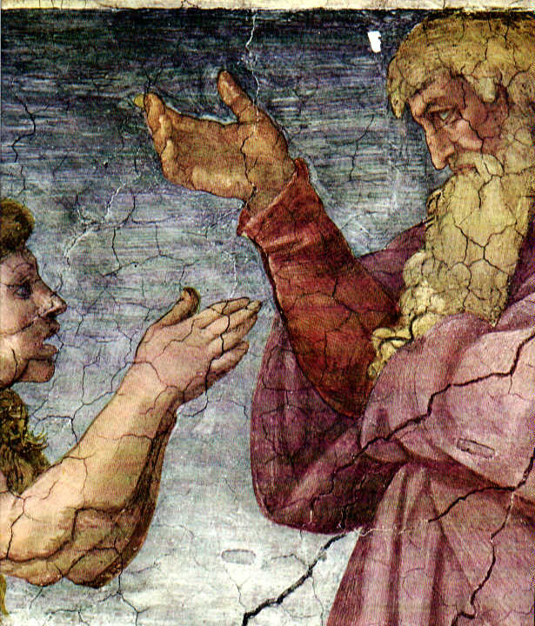
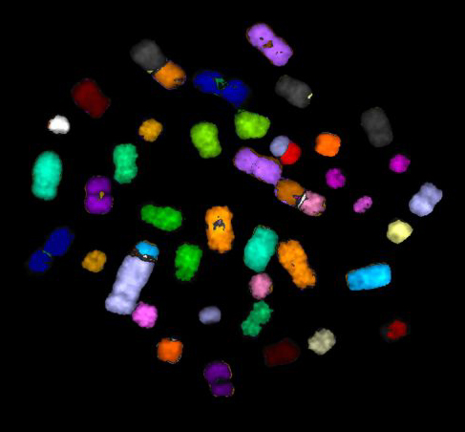
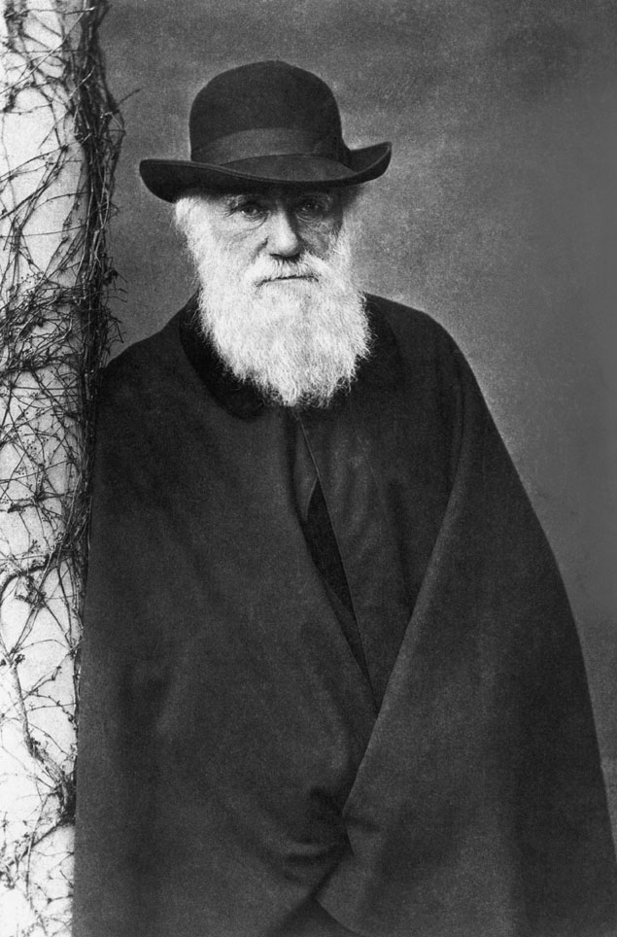
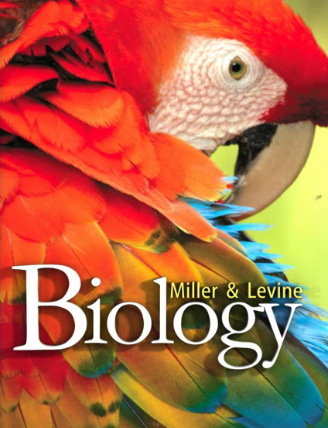
Teaching Evolution
in a Climate of Controversy
Even with NGSS, the battles continue
Ken Miller
Department of Biology
Brown University
4/1/16

Slide 2

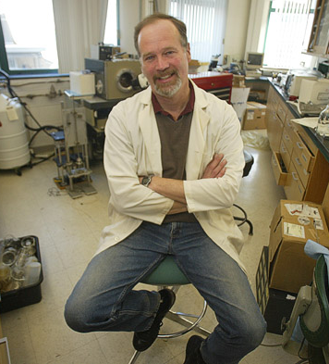
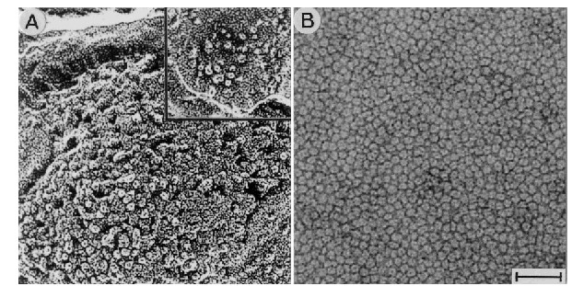
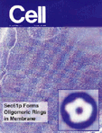
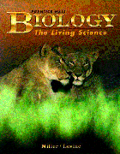
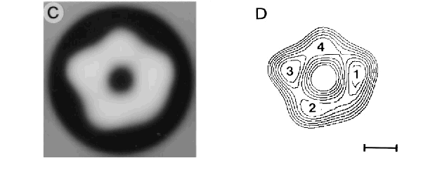
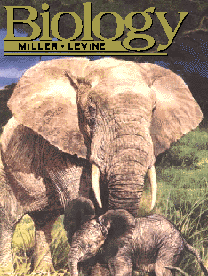
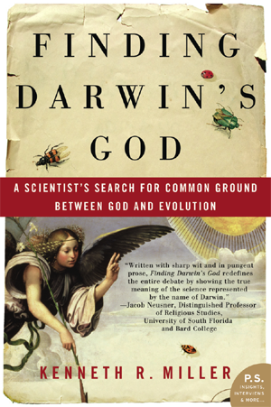
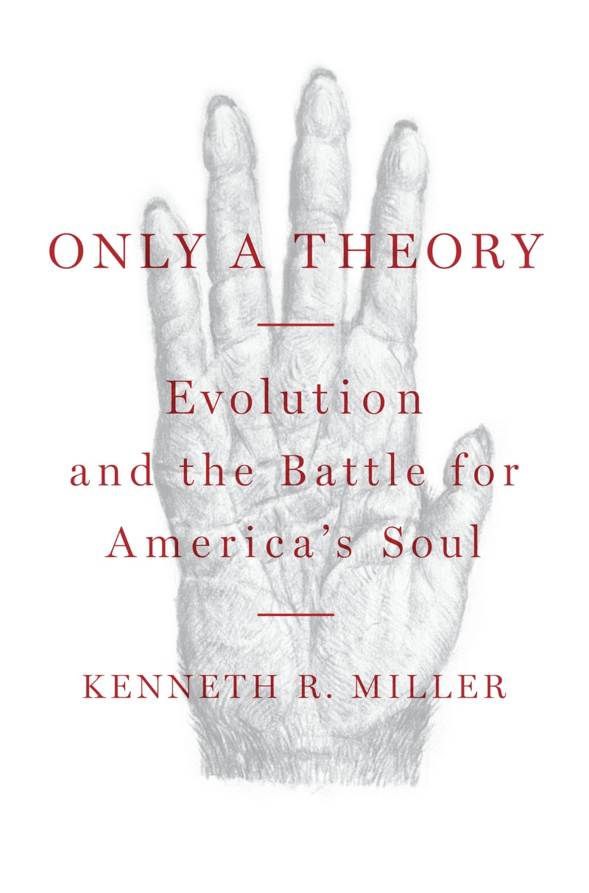
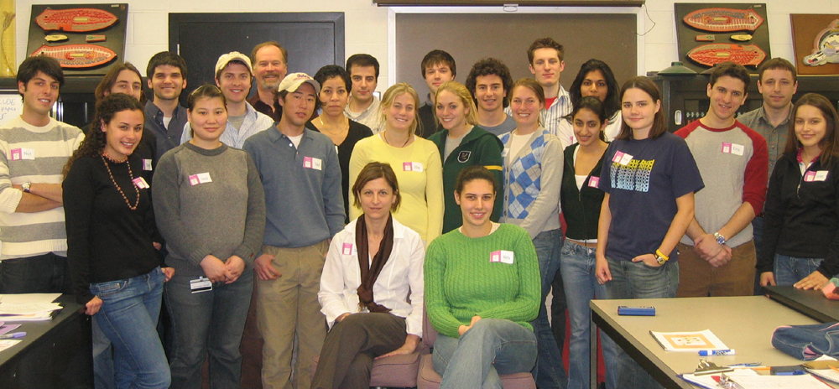


Slide 3
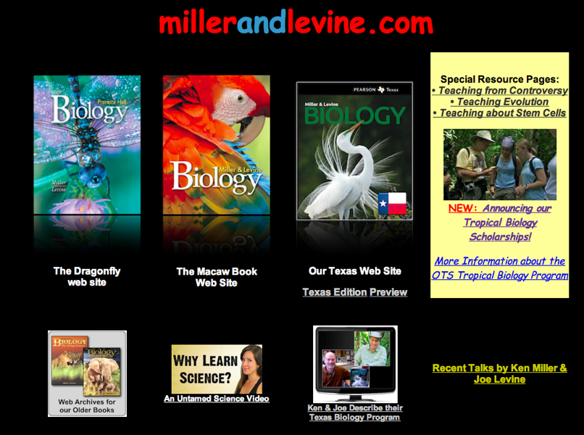

Slide 4

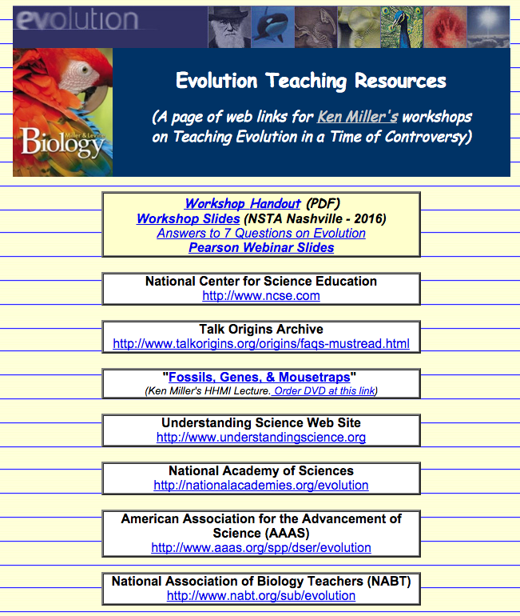

millerandlevine.com/evolution

Slide 5



Slide 6
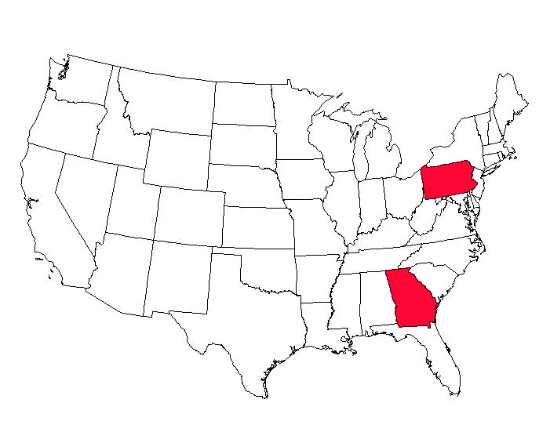
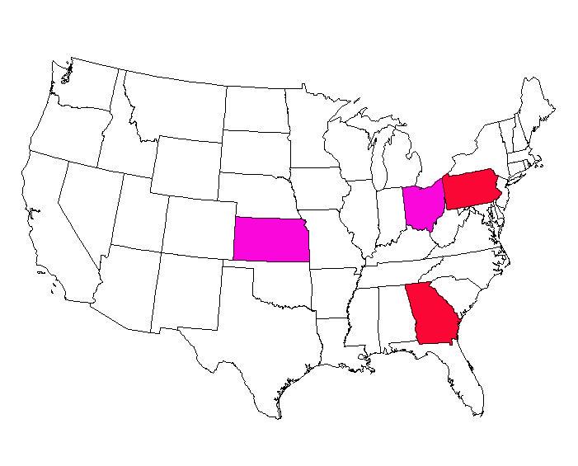
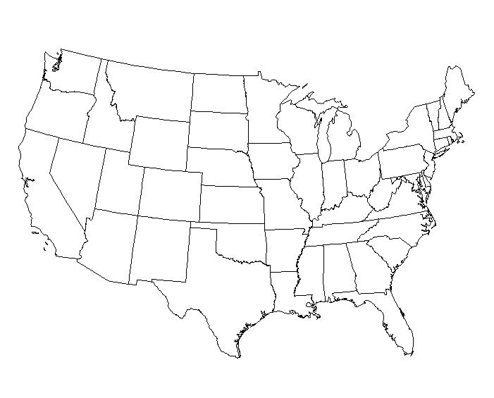
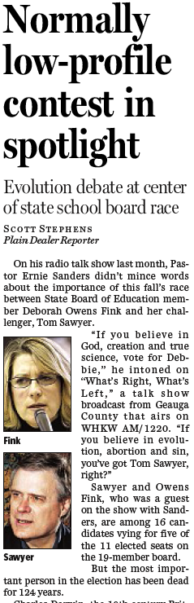


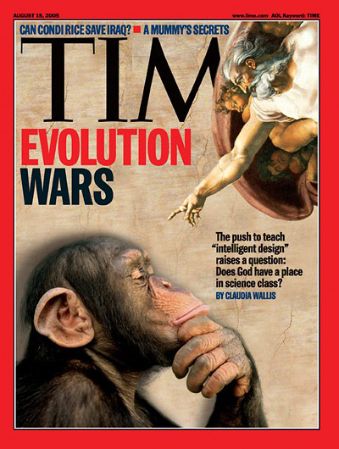
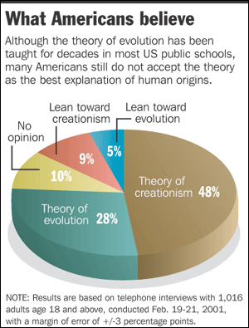
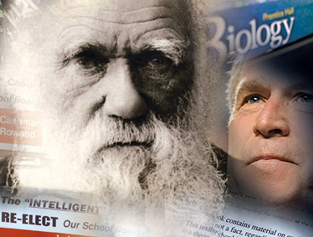
2006: Evolution at issue in 2 state elections
2004-2005: Evolution at Center of 2 Federal Trials
Evolution is an Issue that Divides Americans
“If you believe in God, creation, & true science, vote for Debbie.” .... “If you believe in evolution, abortion, & sin, vote for her opponent.”
Notes:
• All of these drawings are my own. (Ken)

Slide 7
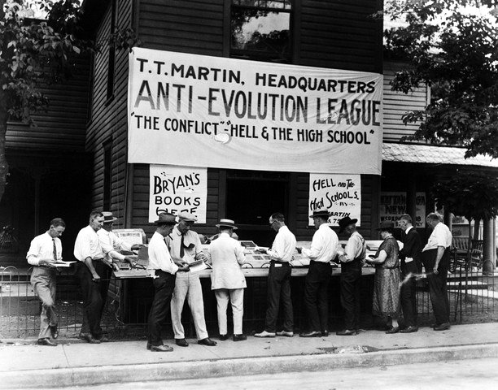

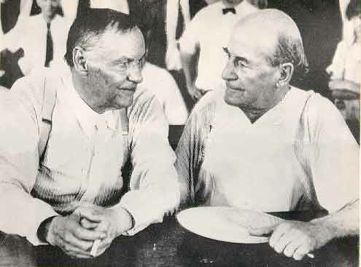
1925: Didn’t the Scopes “Monkey Trial” settle all of this?
Notes:
Slide added for NABT - Denver

Slide 8
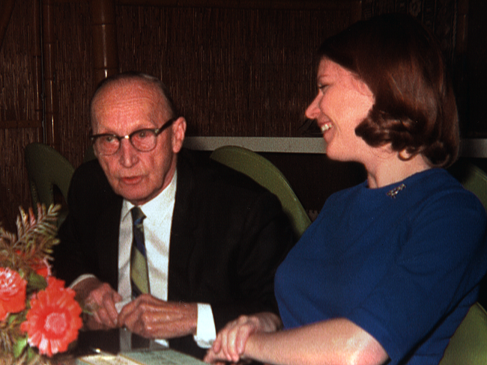
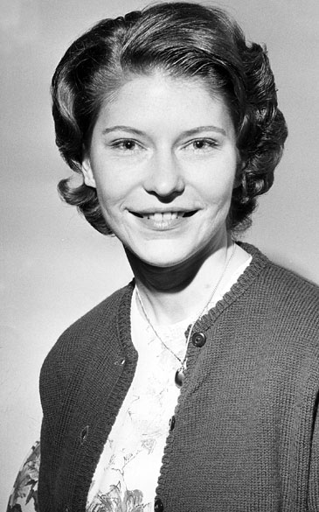
No.
• John Scopes was convicted - and the Butler Act remained on the books.
• Teaching evolution remained banned in 6 states.
Until 1965, when Susan Epperson, a second year Biology teacher in Little Rock, filed a lawsuit against the state of Arkansas.
Notes:
Slide added for NABT - Denver

Slide 9

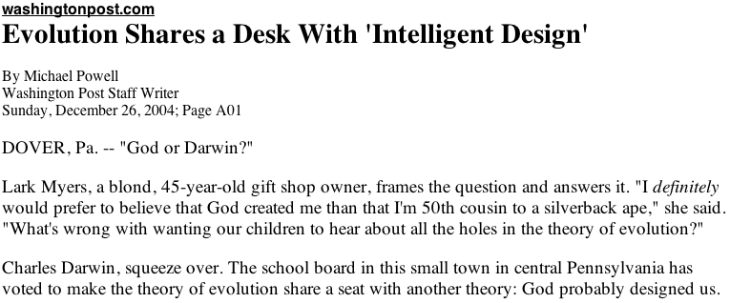
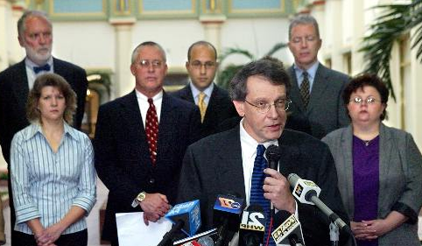

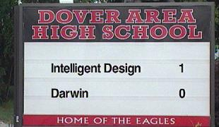
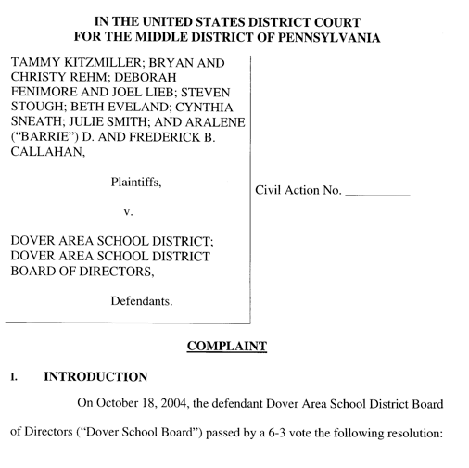

2004: The Dover (PA) school board votes for an “intelligent design” lesson in biology.
Notes:
Current battle — Dover, PA

Slide 10
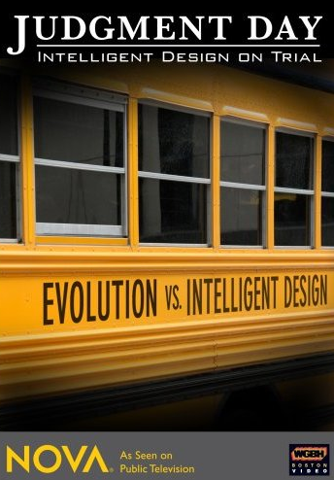
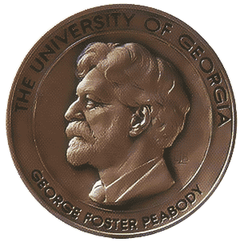
Judgment Day
PBS - November 13, 2007

Slide 11
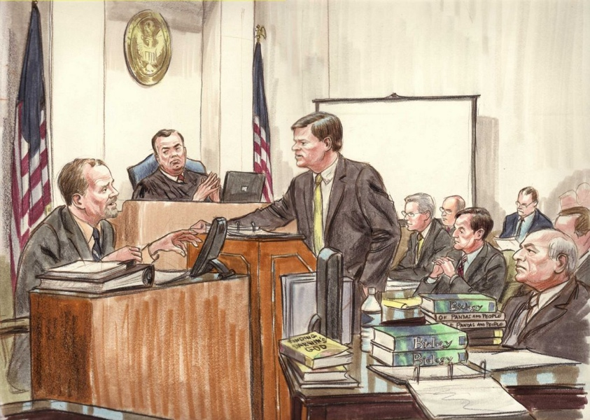
Result in court?
The trial demonstrated the collapse of ID as scientific theory.

Slide 12


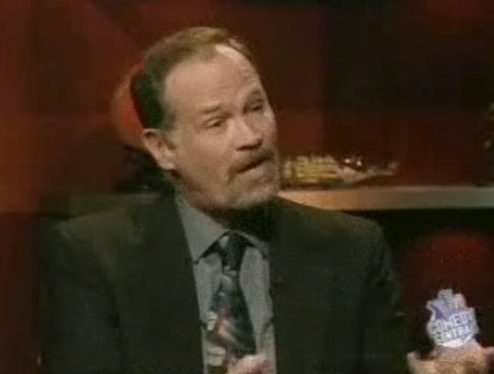
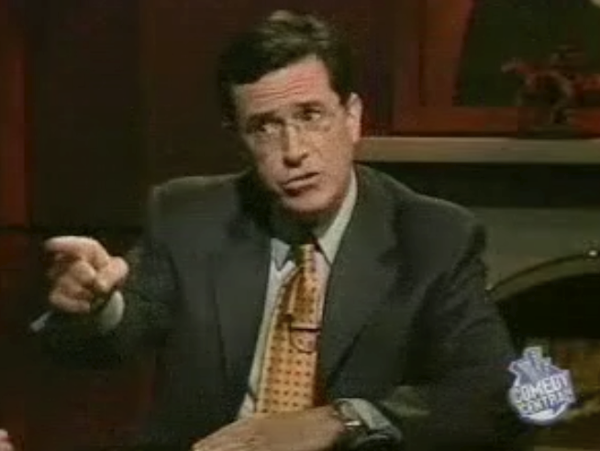

Slide 13
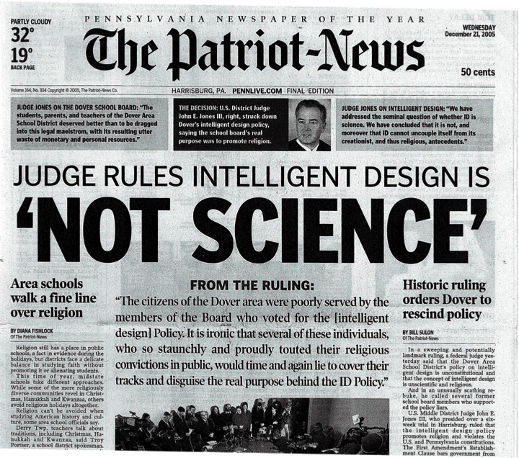



Slide 14
But: Despite this trial, the battle isn’t over.

Slide 15
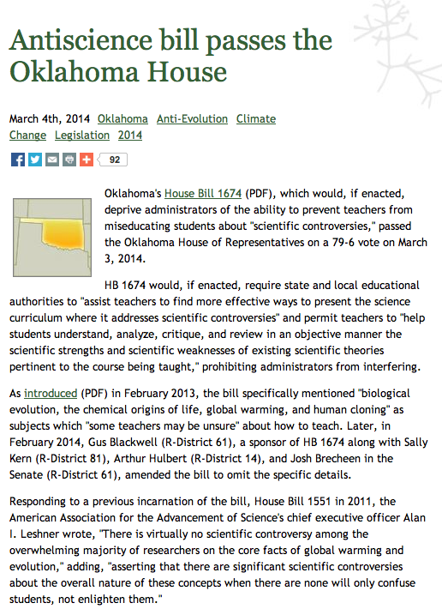
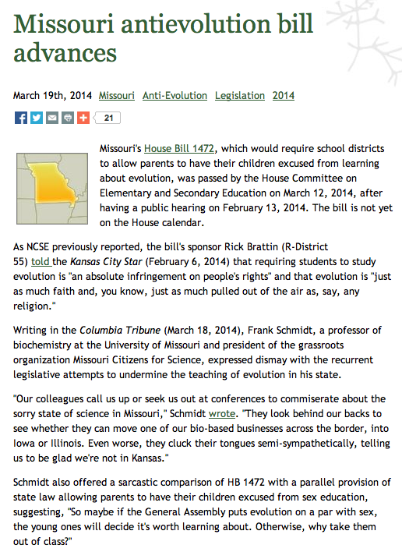
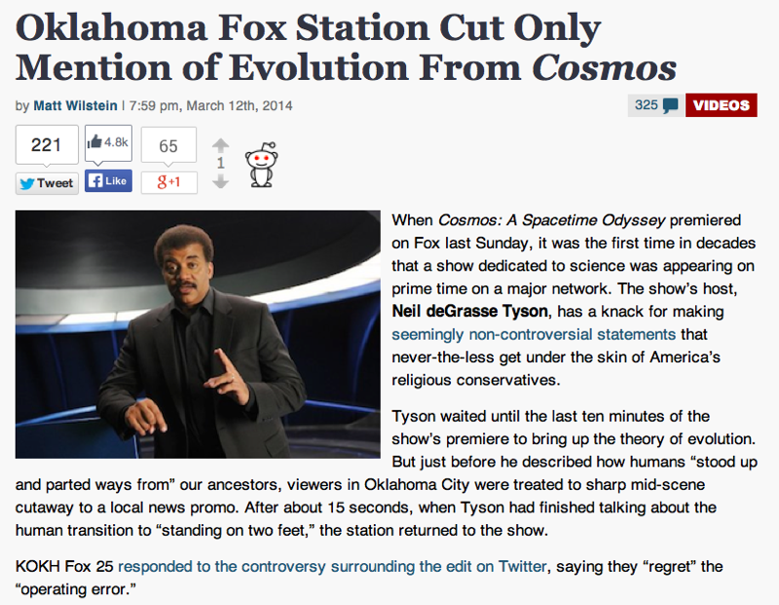

Slide 16
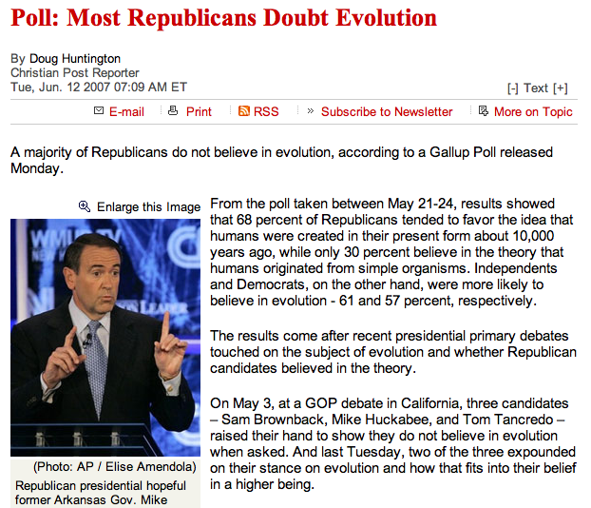
Mike Huckabee’s rejection of evolution is typical of positions taken by many culture war conservatives.
Mike Huckabee: “If anybody wants to believe that they are the descendants of a primate, they are certainly welcome to do it.”

Slide 17
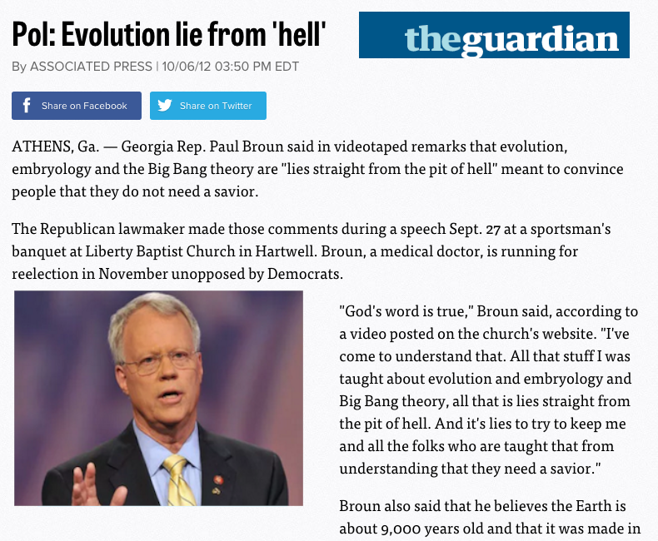
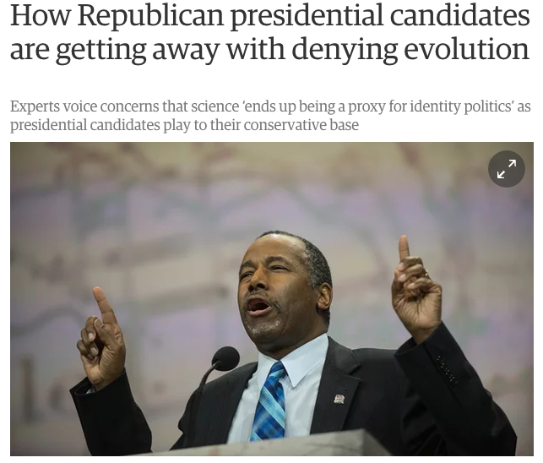


“The scientific evidence doesn't support global warming. For the last 18 years, the satellite data - we have satellites that monitor the atmosphere.
“The satellites that actually measure the temperature showed no significant warming whatsoever. You can go and look at the data. And by the way, this hearing - we have a number of scientists who are testifying about the data. But here's the key point. Climate change is the perfect pseudoscientific theory for a big government politician who wants more power. Why? Because it is a theory that can never be disproven.”

Slide 18

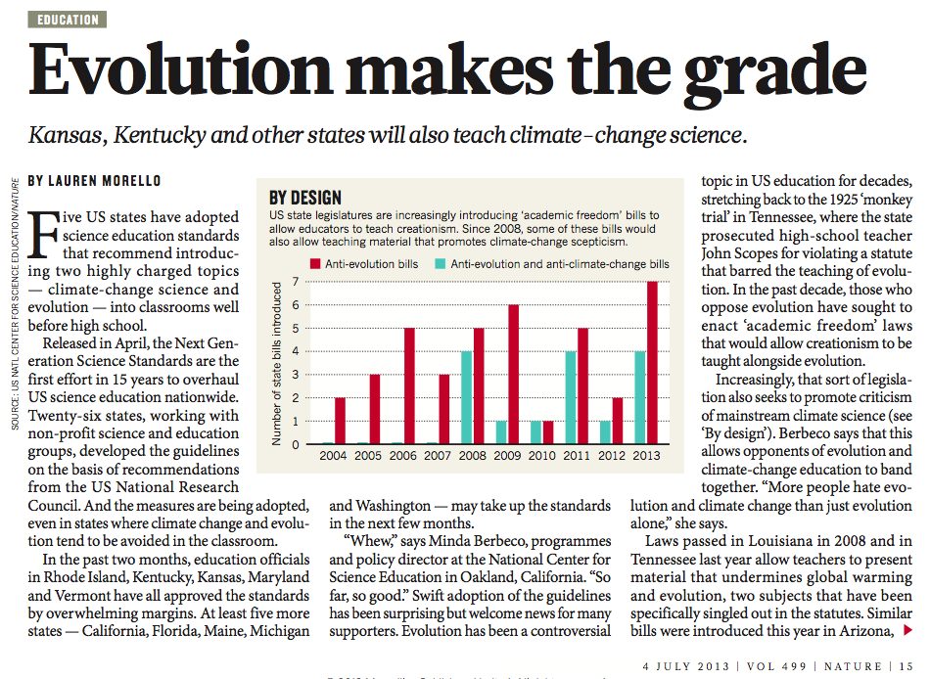
The NGSS Biology Standards focus on evolution

Slide 19
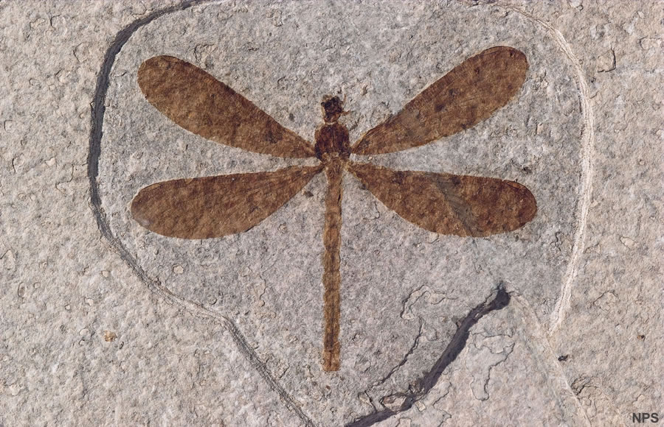
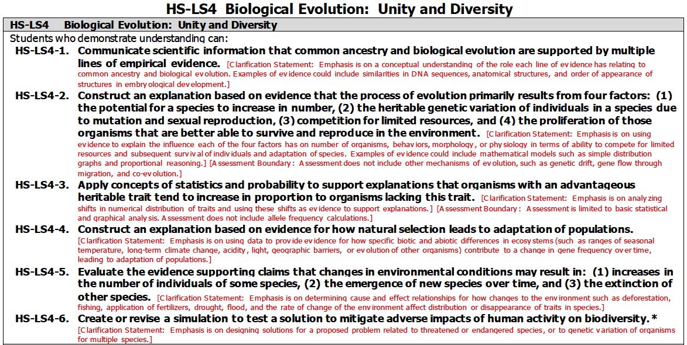

Slide 20
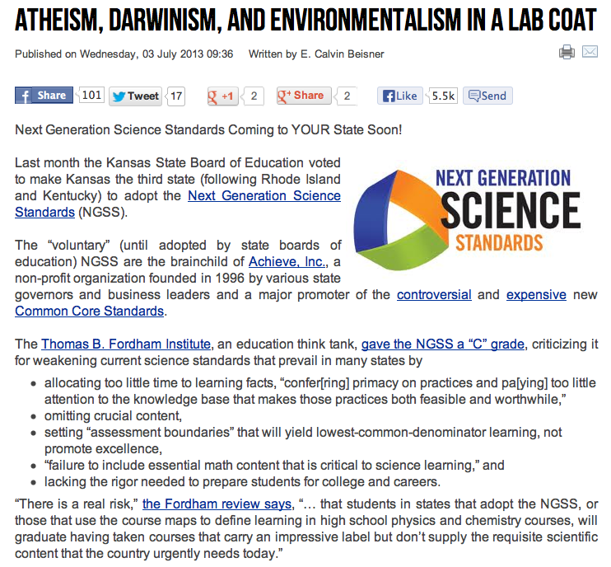

But the NGSS Evolution standards have been called “Atheistic,” and slandered as part of the Common Core

Slide 21

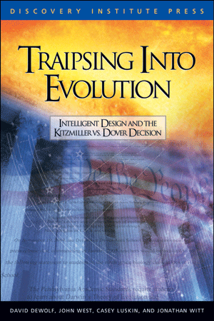

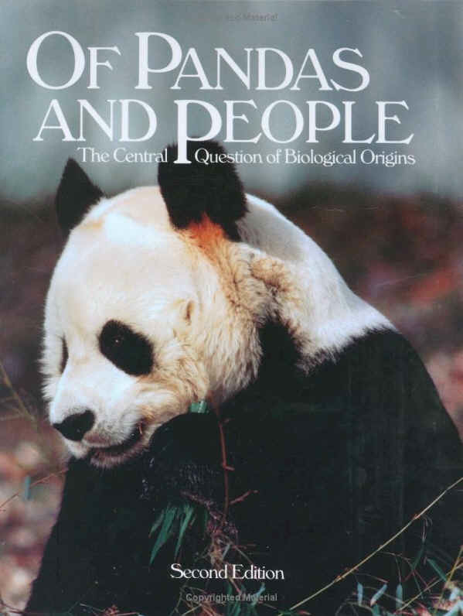

Anti-Evolution Resources are Everywhere

Slide 22
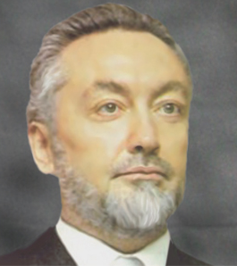
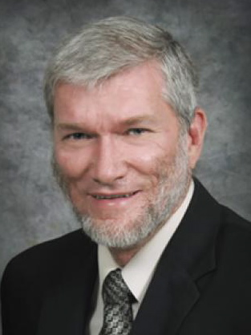


Does this mean that the Critics of Evolution are Correct?
No!
Not on the fossil record.
Not on the mechanism.
Not on the genetic record.

Slide 23



In the 150 years since Darwin published On the Origin of Species, discoveries in all these fields have served as independent tests that could have supported or refuted Darwin’s work. Astonishingly, every scientific test has supported Darwin’s basic ideas about evolution.
So, what’s the right strategy?
First, answer their arguments.

Slide 24
1) What scientific experiment has proven Darwin’s theory of macro-evolution?
Charles Darwin did not develop a “theory of macro-evolution.” Rather, Darwin was responsible for what we call today the theory of evolution by means of natural selection. His ideas had four main points, each of which is testable scientifically.
- Substantial variation exists in natural populations.
- Many more offspring are produced by each species than can possibly surivive to maturity.
- As a result, there is a struggle for existence and reproductive success.
- Characteristics beneficial in this struggle for existence will tend to become more common in a population, changing the characteristics of a species.
From these four observations, each of which have been experimentally verified, he drew a conclusion:
- Over time and given a steady input of new variation into a population, these processes lead to the emergence of news species.
As you will see, this conclusion has also been verified. We do indeed see the emergence of new species in the world around us, and I will provide several examples in a moment.
2) What is the mechanism that causes this to occur?
The mechanisms that produce the genetic changes that drive evolution are well known. They include mutations in protein-coding genes, mutations in regulatory genes, gene duplication and amplification, transversions, translocations, genetic recombination, and horizontal gene transfer. Now we have been able to obtain the complete DNA sequences of so many organisms, we can indeed confirm that these mechanisms are capable of producing the genetic changes necessary to produce new species with novel characteristics.
3) Where did the information in DNA come from?
The information in DNA comes from variation produced by the genetic mechanisms listed above, and the process of natural selection. For example, in just a few decades, a species of bacterium (specifically, Flavobacterium) has evolved a new gene that breaks down chemical compounds used in the synthesis of nylon. Where did the information in this new gene come from? From the processes outlined in my answer to your second question (above), and the process of natural selection. These bacteria evolved in ponds of waste products near nylon-producing factories. In such environments, the gradual appearance of an enzyme capable of metabolizing nylon byproducts was strongly favored by natural selection.
Similar studies have shown the development of new genetic information in many systems, and the answer in each case is that genetic information is produced by the selection of favorable variants of DNA sequences. Now, that information isn't "free." It comes at great cost. The species generates many hundreds (or thousands) of unsuccessful variants for each one that actually improves its chances of survival. That means that the new information produced by variation and selection requires a substantial input in terms of time, food, and energy.
How do you respond to challenges like this?

Slide 25
4) How did dead matter turn into living matter?
"Dead" matter turns into living matter all the time, as I am sure you know. That takes place every time we eat a candy bar or munch on a sandwich. The dead matter of our food is converted into living matter by the process of metabolism.
However, I assume that your question is about the origins of the first living cells on planet Earth. The truth is that at this point no one can say for certain, and this is typical of many unsolved questions in science. Do keep in mind, however, that the origin of life is a completely different question from the origin of species. Darwin’s theory of evolution by natural selection deals with the ways in which species change and split, giving rise to new species. It is not a theory of the origin of life.
If you care to open our textbook to pages 553-558, you will see a complete treatment of this question. The sub-heading for this section (Lesson 15.3) of out textbook is entitled "The Mystery of Life's Origins," and I would emphasize our use of the word "mystery." We are quite direct in telling students that we do not have a complete picture of the origin of the first living cells. However, that does not mean that we haven't glimpsed some interesting clues to the puzzle. These include, as I am also sure you know, the fact that the organic building blocks of life form quite easily under conditions present on the primitive earth. This has been confirmed not only by laboratory experiments, but also by the recovery and identification of such compounds from meteorites and comets.
6) Why do we only see animals reproducing after their own kind? Has Darwinian evolution stopped?
You're quite wrong in suggesting that we don't see current examples of evolution in the living world. In fact, it is quite easy to see the process of speciation in action. I would especially recommend these studies of speciation:
Wake (1997) Incipient species formation in salamanders of the Ensatina complex. Proceedings of the National Academy of Sciences 94: 7761-7767.
Filchak et al (2000) Natural selection and sympatric divergence in the apple maggot Rhagoletis pomonella. Nature 407: 739-742.
Mosil et al (2002) Host-plant adaptation drives the parallel evolution of reproductive isolation. Nature 417: 440-443.
I'd be glad to send you PDF copies of these papers if you are interested. In addition, more examples are given in this web resource, and I'd invite you to examine them in detail:
http://www.talkorigins.org/indexcc/CB/CB910.html
So, the bottom line is that evolution has not stopped at all. In fact, it proceeds every day in the world around us. All we have to do is to look.
5) How did the first living cell form and how did it know what parts were necessary for it to function?
Like your Question #4, this is not a part of the theory of evolution. We do, however, address this unsolved question in Lesson 15.3 of our textbook. On these pages, we describe fossil and geologic evidence for the appearance of the earliest cells on Earth, and also describe the endosymbiotic theory of the origin of cellular organelles.
Not for a second would any biologist argue that the first living cells "knew" which parts they needed. One of the key characteristics of life is the process of replication (or, reproduction). Once a self-replicating chemical system became established on the primitive earth, the stage for cellular life would have been set, requiring only that such systems developed ways to separate their own chemistry from the rest of the world via a cellular membrane. And, as I am also sure you know, certain chemical compounds assemble spontaneously into membrane-like structures.
Our textbook does not present any of these issues as solved problems. Rather, we have done our best to ensure that students understand the current state of research on origin of life.

Slide 26

7) In the fossil record we see evidence of the Cambrian explosion where all species appeared at once. Where is the evidence that supports Darwin’s tree of life?
The notion that "all species appeared at once" in the Cambrian period is a common misconception. The process took between 10 and 20 million years That’s actually a pretty long time. Plus, as I’ll detail below, these animals didn’t come from nothing.
I’ve seen discussion sites where people clearly think that “all major animal groups” means all the kinds of animals we see today. For example, I’ve seen the assertion that whales were found in the Cambrian. This is so absurd as to not be worth commenting on. This issue is that many of the animals known then, all of which are long extinct, can be argued to be early members of today’s major groups of animals (phyla). The only animal found in the Cambrian that seems to belong to our phylum (Chordata) --- Pikaia --- would be thought by most people to look like a little worm. The only way we can link it to us is some specialized features not seen in any other animals ---- for example muscles along its side that form in a zig-zag pattern (like you see on a piece of fish), not in simple straight segments as in an earthworm. In other words, it is only by applying evolutionary analysis to Pikaia that we can identify it is a possible ancestor to other chordates, ourselves included.
In simple terms, "all species" did not appear in the Cambrian, nor did all major groups of organisms. Mammals, reptiles, amphibians, fish, insects, flowering plants, and other major groups did not appear until many millions or hundreds of millions of years after the Cambrian.
Now, where did the Cambrian animals come from? Did they arise without ancestors? No. We actually have good fossil evidence of fairly complex animals stretching into the Precambrian. There is an animal called Kimberella that is known from the Ediacaran fauna, 5-10 million years before the Cambrian that is certainly a complex animal, perhaps some sort of mollusk (see http://en.wikipedia.org/wiki/Kimberella), and there are lots of other animals then that might represent some sort of more primitive forms such as sponges or jellyfish. So there was plenty of biology going on before the Cambrian radiation, and these animals didn’t appear suddenly from nowhere.
Pikaia

Slide 27






"Astonishingly, every scientific test has supported Darwin’s basic ideas about evolution."
You seem to take issue with this statement, and I certainly drew the impression from your email that the seven questions you listed were intended as challenges to this assertion in our textbooks.
Quite frankly, the statement in our text is still correct. Please remember that we referred to "Darwin's basic ideas about evolution." Those ideas were essentially that processes acting in the living world today, including variation and natural selection, are sufficient to account for the origin of species. More than a century and a half of study has indeed confirmed those ideas. It is a fact, of course, that there are many characteristics of living organisms and many events in earth history that cannot yet be completely explained by evolutionary theory. But the same is true of any scientific theory — including the basic theories of physics such as gravitation, atomic theory, string theory, and quantum mechanics. The existence of unexplained phenomena is not evidence against a particular theory, and that's why we made the statement we did.
It is worth noting that Darwin sketched the basic outlines of his theory of evolution in an age before fields such as genetics, biochemistry, molecular biology, and genomics were established. To be valid, evolutionary theory had to make and fulfill scores of predictions in each of these fields, and it has. Evolutionary theory has successfully been applied to modern studies in biology in countless ways, and it has survived every attempt at disproof.

Slide 28




Kitzmiller did not settle the issue
example: Texas, 2013

Slide 29





Slide 30




Ide Trotter
One individual on a volunteer review panel submitted a list of 20 supposed “errors” in our textbook.

Slide 31






We responded with an 11-page document, addressing each of the so-called errors in detail.

Slide 32


“The three reviewers found that none of the ‘mistakes’ were actually wrong. They recommended no changes to the book so the book will now be placed on the approved list,” Debbie Graves Ratcliffe, a spokeswoman with the Texas Education Agency, said Wednesday.

Slide 33

Science Under Siege?
1) Teach the science. Show the factual evidence first, then the theories that unify and explain those facts.
2) Don’t shy away from controversy. If the science points in a clear direction, don’t hesitate to say so.
3) Remember that science is not business or politics or religion. Leave the implications of science to your students.

Slide 34


NCSE now supports Climate Science, as well as Evolution
www.ncse.com

Slide 35


www.millerandlevine.com/evolution

Slide 36

www.nsta.org/evresources

Slide 37





Slide 38




Slide 39



http://www.pbs.org/evolution

Slide 40




http://evolution.berkeley.edu/

Slide 41

from the National Academy of Sciences:
www.nas.edu

Slide 42

I’d be glad to visit your classroom to talk about evolution
Speciation
Human Genome
Irreducible Complexity
Fossil Record
Bacterial Flagellum
“Intelligent Design”

Slide 43



www.hhmi.org/biointeractive
HHMI:
Free DVD — from the Howard Hughes Medical Institute

Slide 44
General Guidelines & Suggestions
Emphasize that the purpose of science education is not to compel belief — it is to promote understanding.
Scientists don’t “believe” in scientific theories — they accept or reject them on the basis of the evidence.

Slide 45
General Guidelines & Suggestions
Make certain that students don’t see evolution as a subject that places their most closely-held beliefs at issue.
... and, emphasize the process by which scientific ideas are developed — not from preexisting beliefs, but from observation and experiment.

Slide 46


But more “information” may not be the key to winning public acceptance.
In fact, it may actually harden anti-science views.

Slide 47

The problem may be “Cultural Cognition”
An unwillingness to identify culturally with the Scientific Community
Under these circumstances, bombarding citizens with more information (“97% of SCIENTISTS AGREE”) doesn’t diminish polarization but instead aggravates it by amplifying the association between competing identities and competing positions on climate change.
What needs to be changed are the circumstances that make recognizing valid scientific information hostile to the identities of reasoning citizens.
“Is this possible? Sure: just ask a good high school teacher to show you how.”

Slide 48


As Science Educators, we need to speak up.

Slide 49



Is there hope? A 2015 Pew Foundation report showed something remarkable.
Young people are much more accepting of evolution.

Slide 50






Slide 51




Assemble the case historically . . .
. . . allowing students to see the scientific development of the theory.

Slide 52


“Succession of types.”
Armadillos are native to the Americas, with most species found in South America.
Glyptodont fossils also unique to South America.
Why should extinct armadillo-like species & armadillos be found on same continent?

Slide 53


Mylodon (left) Giant ground sloth (extinct)
Modern sloth (right)
“This wonderful relationship in the same continent between the dead and the living will, I do not doubt, throw more light on the appearance of organic beings on our earth, and their disappearance from it, than any other class of facts.”
Chapter 8, Voyage of the Beagle.

Slide 54



“This wonderful relationship in the same continent between the dead and the living will, I do not doubt, throw more light on the appearance of organic beings on our earth, and their disappearance from it, than any other class of facts.”
Chapter 8, Voyage of the Beagle.

Slide 55

A Consistent trend in biology teaching:
• De-emphasis on phylogenetic survey
• Result: compressed animal & plant chapters
Our approach:
Instead of skimping on evolutionary systematics, make them a feature.
Notes:
New Slide for NABT - Denver

Slide 56


Notes:
New Slide for NABT - Denver

Slide 57



New Systematics
5-Kingdom?
6-Kingdom?
3-Domain?
Cladistic Analysis unifies Classification & Evolution
Notes:
New Slide for NABT - Denver

Slide 58





Evolution permeates Biology - and that’s how we should teach it.
Notes:
New Slide for NABT - Denver

Slide 59



ken.miller@brown.edu
401-863-3410
levinejs@me.com
millerandlevine.com

