Slide 1
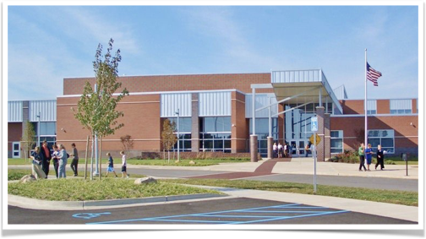
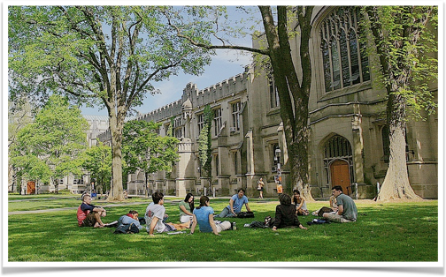
College Readiness in Science
What’s Ideal?
What’s Real?
Ken Miller
Professor of Biology
Brown University
10/19/18

Slide 2
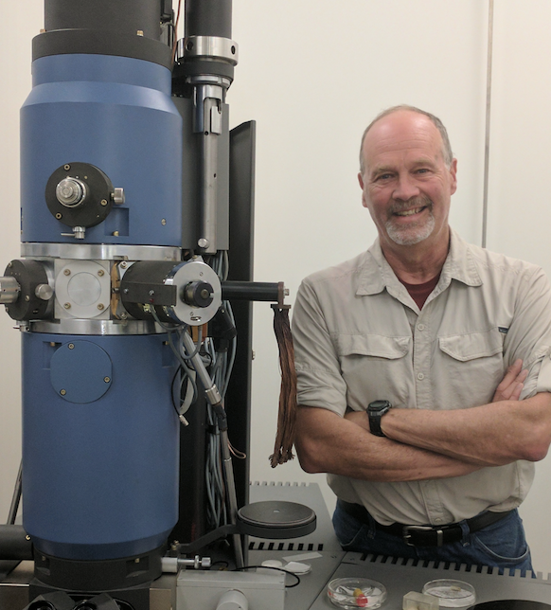
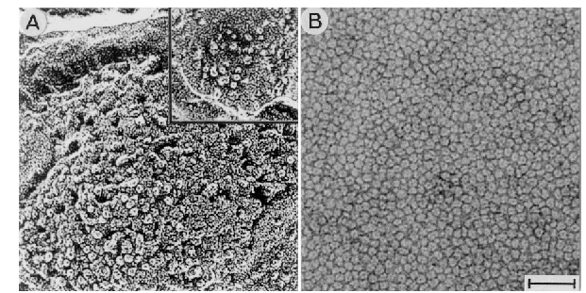
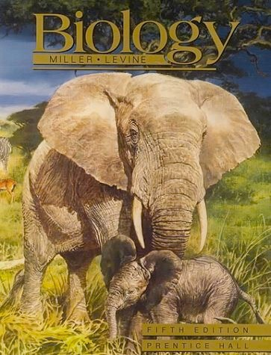
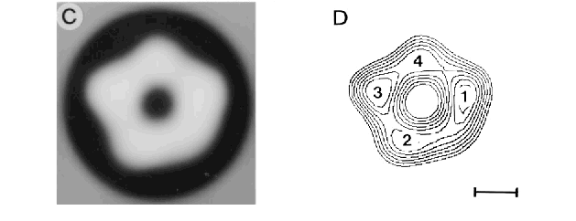

Slide 3
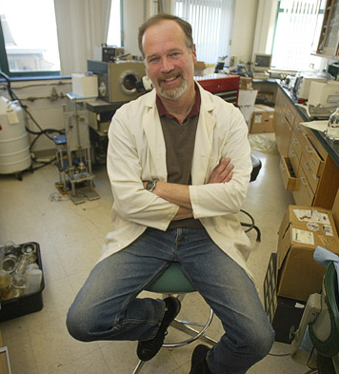
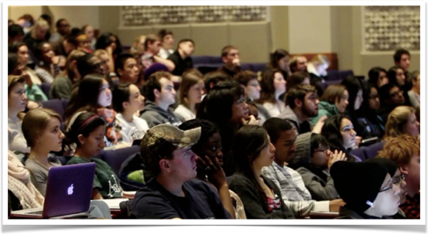
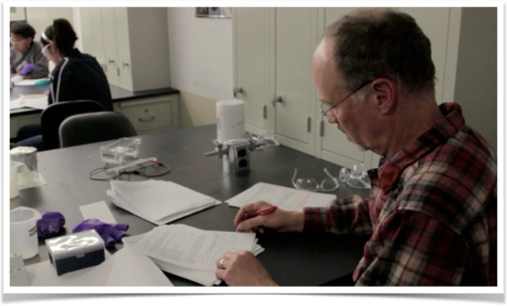
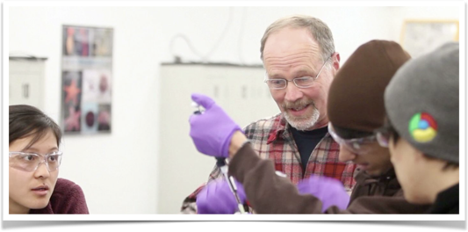

Slide 4
1) The US workforce will require more education and skills.
2) Low skills jobs provide few opportunities for advancement or security.
3) The skills “mismatch” is real
4) There are many pathways to middle and high skills jobs, but education and training beyond high school is the common denominator

Slide 5
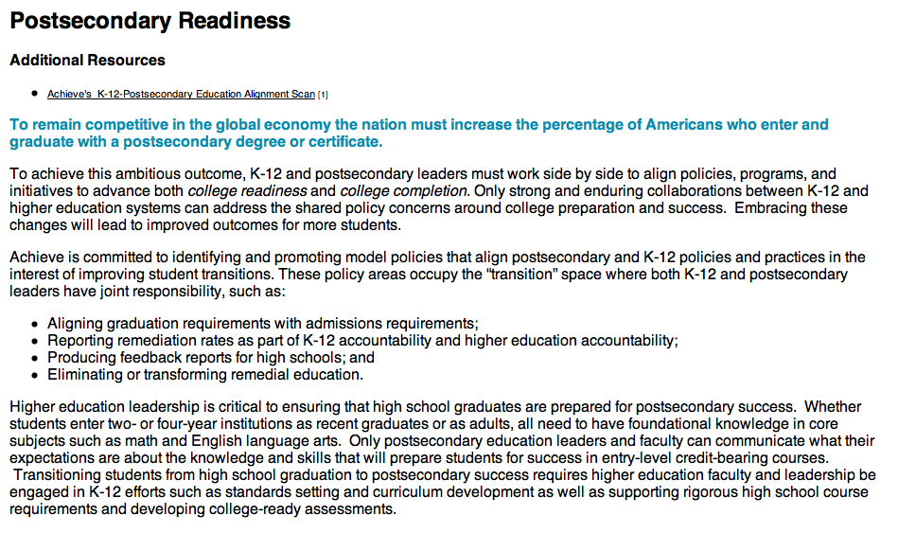
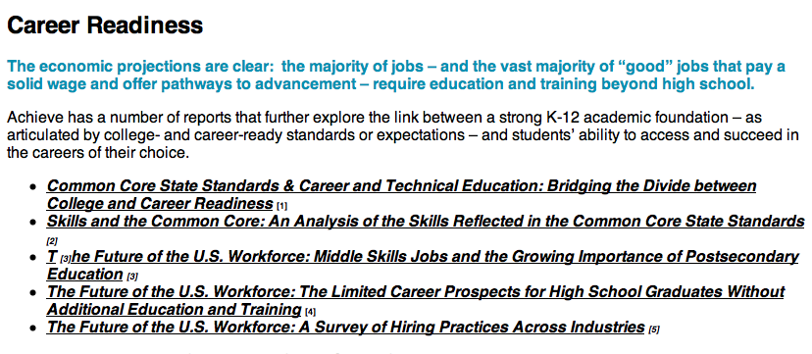

Slide 6
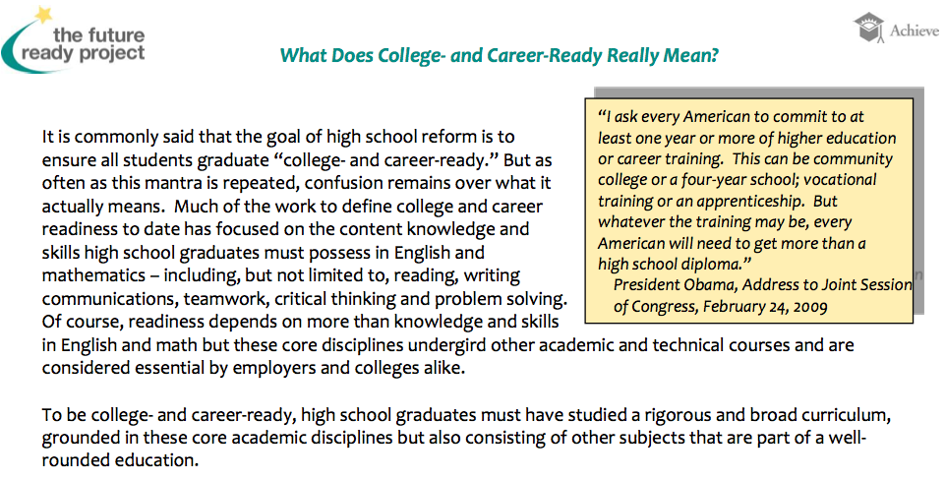
College today means much more than just pursing a four- year degree at a university. Being “college-ready” means being prepared for any postsecondary experience, including study at two- and four-year institutions leading to a postsecondary credential (i.e. a certificate, license, Associate’s or Bachelor’s degree). Being academically ready for college means that a high school graduate has the English and mathematics knowledge and skills necessary to qualify for and succeed in entry-level, credit-bearing college coursework without the need for remedial coursework.

Slide 7
Similar reports produce a series of statements like these:
All students need a more rigorous foundation in literacy, math and science.
• All students need a more rigorous foundation in literacy, math and science – no matter what college or career path they choose.
• College and career readiness is NOT about all students attending four-year colleges or universities; it’s about access to the middle class. Increasingly, access to middle class jobs requires at least some postsecondary education and or training. This means raising expectations for all students, particularly for those students for whom the education system has served the least – minority and low-income students.
• A major challenge is ensuring all students have access to the core academic knowledge and skills they need to make their own career decisions – as opposed to finding themselves with minimal career opportunities due to a lack of academic preparation.
• 80% of jobs are “middle and high” skilled and require education beyond high school (e.g., associate’s, bachelors, and professional, industry-recognized certifications).1
• 62% of new jobs available in 2018 will require some postsecondary education. For employers, this translates to a need for 22 million new workers with postsecondary degrees. Without a dramatic change of course, the U.S. is on track to fall short of this need by a full three million workers.2
• The New York Times recently noted that “more jobs demand much higher math and reading proficiency than in the past.”3 A Pioneer Institute study found that manuals for auto mechanics, plumbers and those that repair appliances are written “up to a Grade 14 reading level.”4
• Data reflect that our students are facing heavy academic competition. On a 2009 international assessment of 15-year olds, over 20 countries had higher average achievement scores that the U.S., but also had higher percentages of students performing at the highest levels of mathematics literacy.
College and career readiness is NOT about all students attending 4-year colleges or universities.
80% of jobs are “middle and high” skilled and require education beyond high school.
62% of new jobs available in 2018 will require some postsecondary education.
Data reflect that our students are facing heavy academic competition.

Slide 8
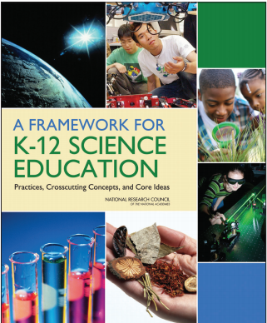
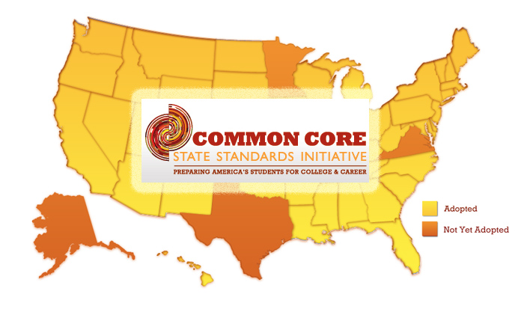
All set against a backdrop of curriculum reform and revision.

Slide 9
What is “College Readiness” (in science?)

Slide 10
Strong intellectual growth throughout the primary and secondary years fostered by increasingly challenging content in the four core subjects and beyond.
The ability to think critically and problem solve in the context of a continuously changing set of circumstances and realities.
The advancement of reading, writing, and numeric skills that enable success in all college courses.
The capacity to communicate effectively with individuals from a variety of cultural and professional backgrounds.
Students that are enrolled in remediation courses in their first year of college have only a 17-39% graduation rate (College Board 2004)
Center for College Readiness (Rice University)

Slide 11
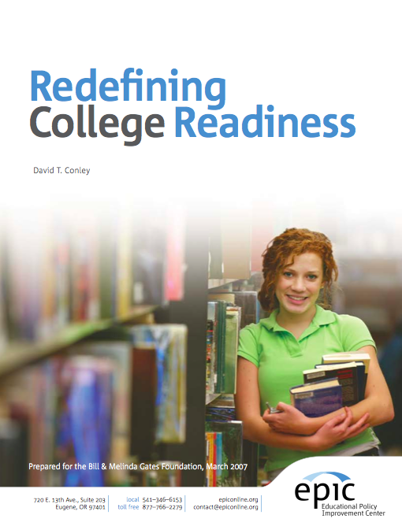
Annenburg Institute for School Reform (Brown University)

Slide 12
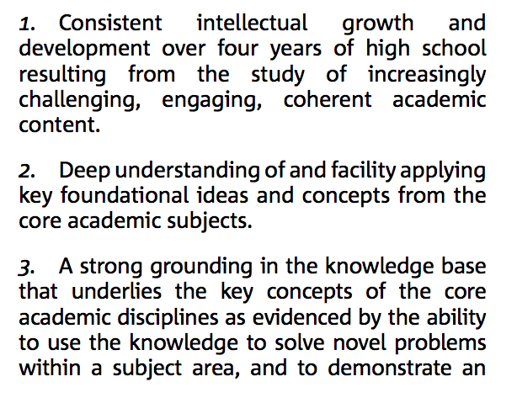
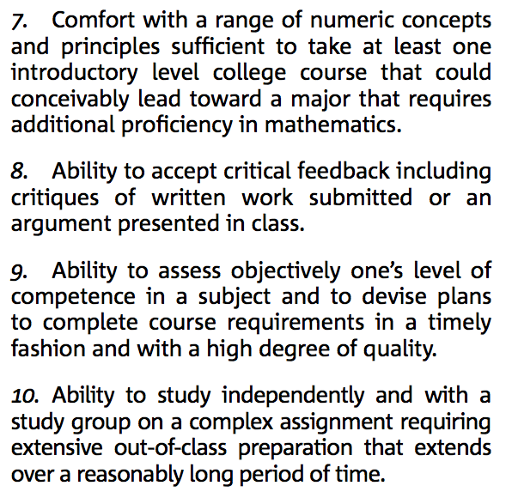
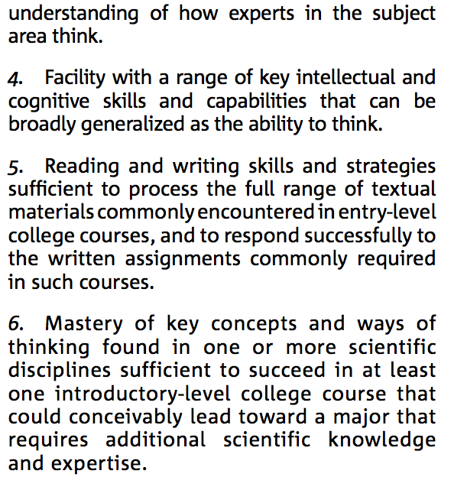
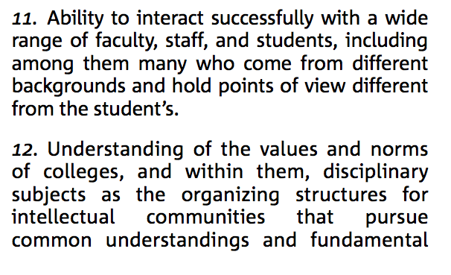

Slide 13
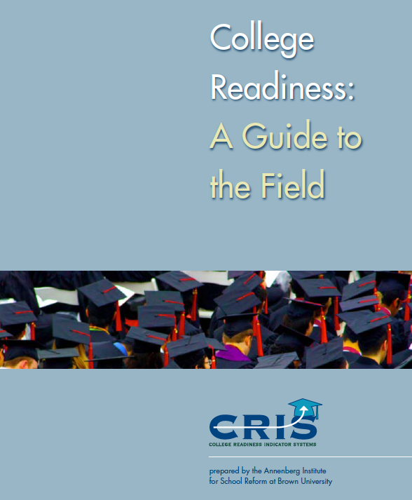
• Academic preparedness refers to the academic
knowledge and skills students need to succeed in
college. These include content-area proficiencies
and key cognitive strategies that span content
areas, such as the ability to formulate and solve
problems, conduct research, and construct an
argument or complete tasks with precision or
accuracy.
• Academic tenacity is defined as the “underlying
beliefs, attitudes, values . . . and accompanying
behaviors that drive students to embrace and
engage with challenging work, and to pursue
academic achievement,” and is also key to students’
academic success both before and
throughout college.
• College knowledge captures the ability to gain
access to postsecondary institutions as well as
successfully navigate through college. These
“contextual skills and awareness” enable students
to, among other actions, apply to college and for
financial aid, develop appropriate relationships
with peers and professors, and be resourceful
learners and self-advocates (Conley 2008).

Slide 14
One Approach:
To provide a list of things students should “know” when entering college.
Why? Because it’s obvious they’re going to be in trouble if they don’t know anything!
Laws of motion, force, mass, & energy.
Earth science basic, volcanism, plate tectonics.
Cell theory, evolution, DNA, RNA, anatomy.
Atoms, molecules, chemical bonding.
Algebra, geometry, trigonometry, calculus.

Slide 15
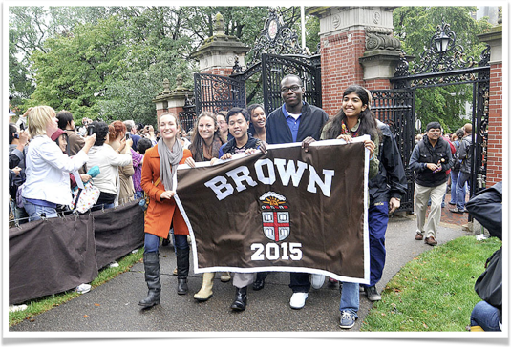
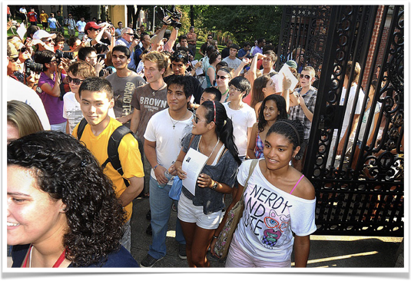
So, it would be great to think that all entering students know these things.
At a highly-selective university, mostly they do. And yet, that’s not enough.

Slide 16
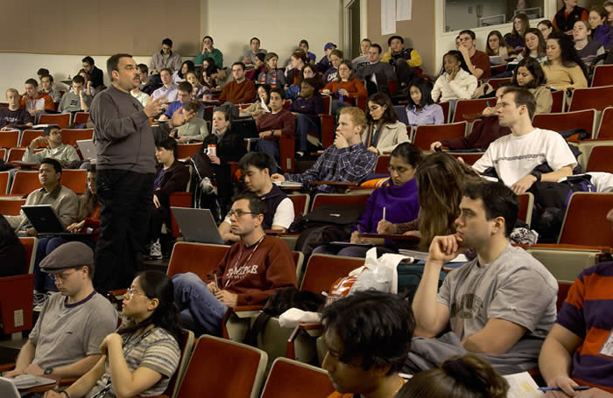
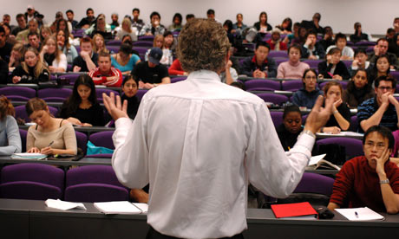
Harsh Realities:
The Lecture
For many students, the passive nature of the lecture is infectious (and not in a good way)

Slide 17
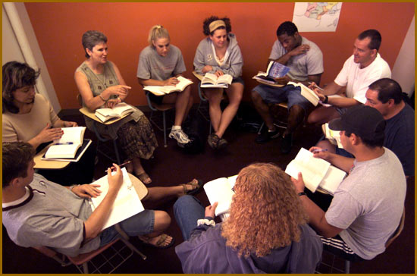
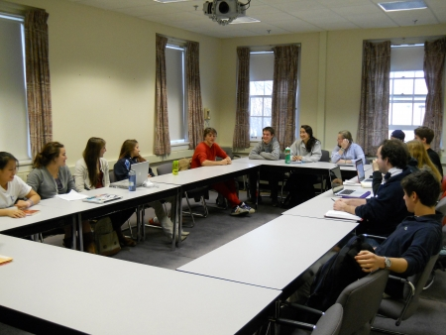
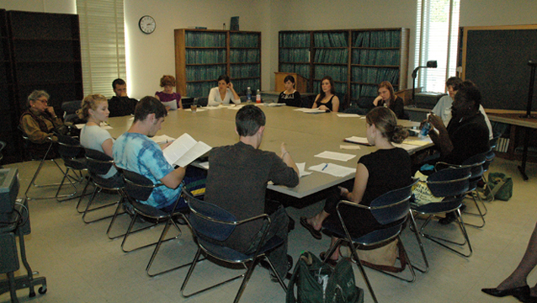
Harsh Realities:
The Seminar or Discussion section
These can be high-pressure “stand and deliver” situations.

Slide 18
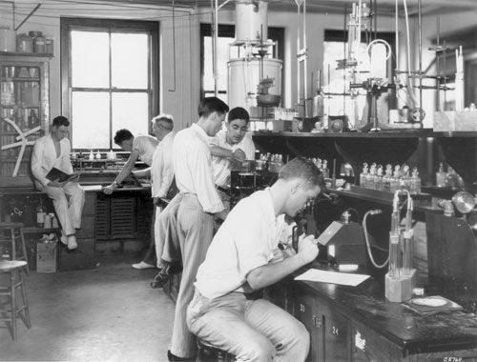
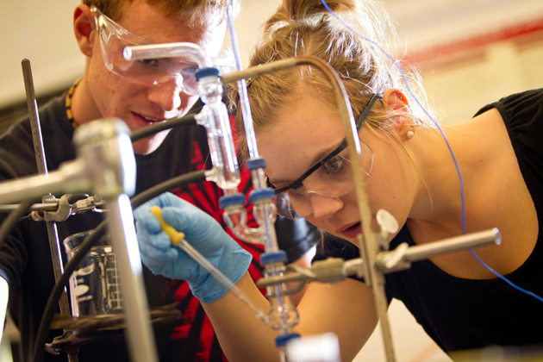
Harsh Realities:
The Science Laboratory
These are much longer than HS labs (up to 5 hours) and can be very demanding.

Slide 19
Harsh Realities:
A Reading load like nothing in high school.

Slide 20
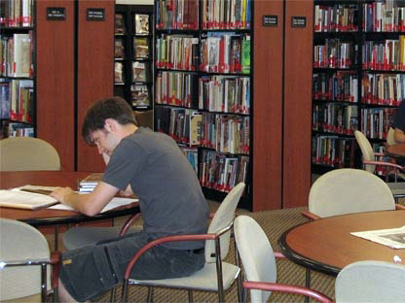
A Final Reality:
We will let you fail. Believe me, we will let you fail!

Slide 21
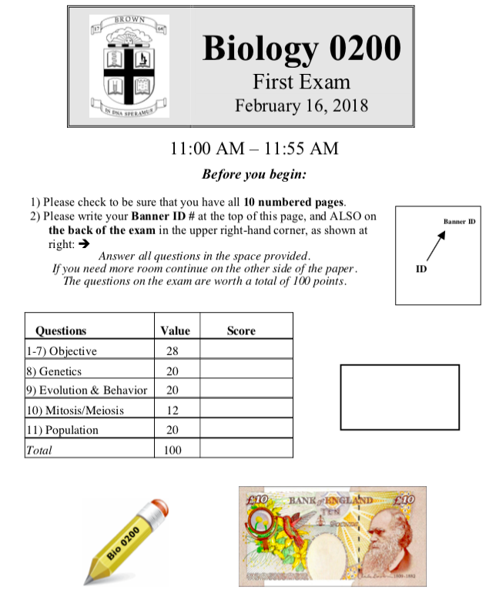
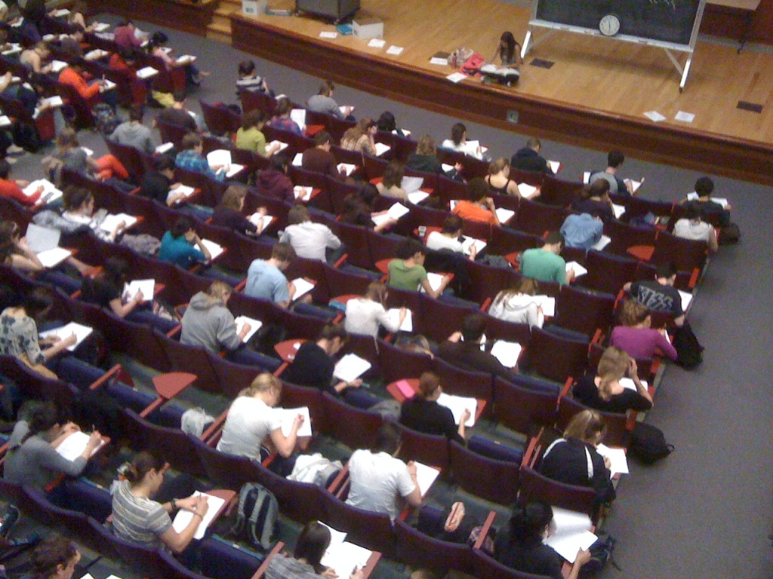
A Shocker:
That first college Science Exam

Slide 22
Take my first-year Biology course as an example.
I try to answer every student question right up front.

Slide 23
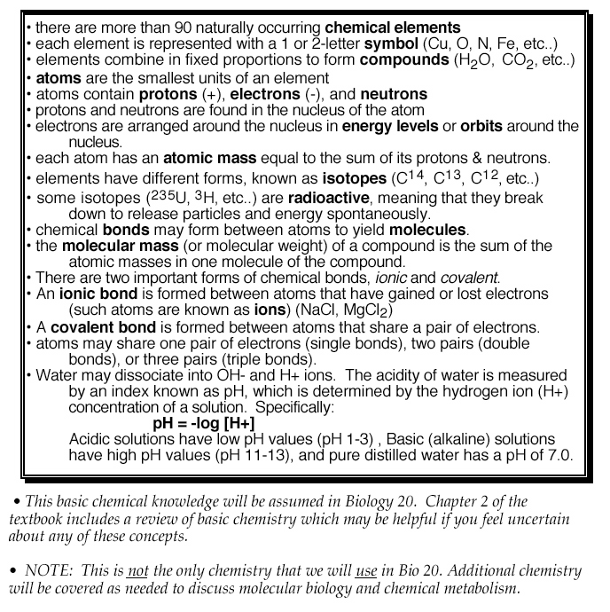
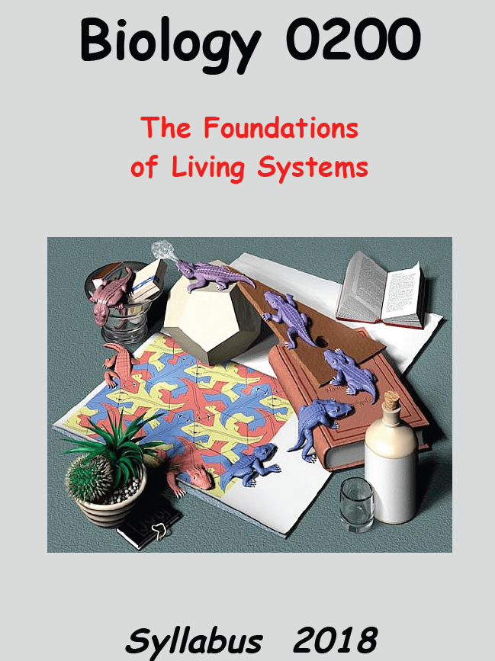
Here’s the chemistry knowledge I expect:
What sort of chemistry background is assumed for Bio 20?
Syllabus Page 4

Slide 24
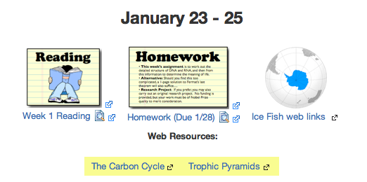
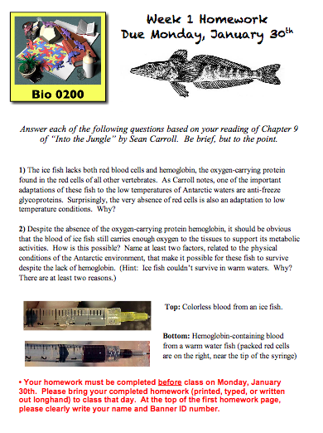
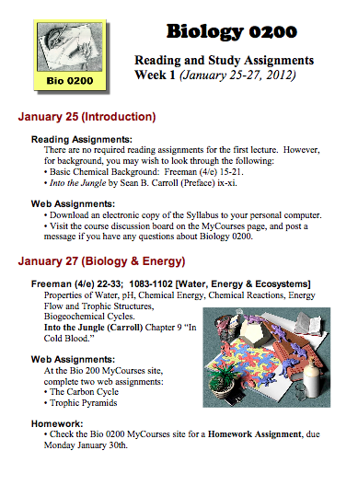
Web Pages include Reading Assignments, Lecture Slides, Exams, & Web Links.

Slide 25
Copies of slides are posted on web site within 24 hours

Slide 26
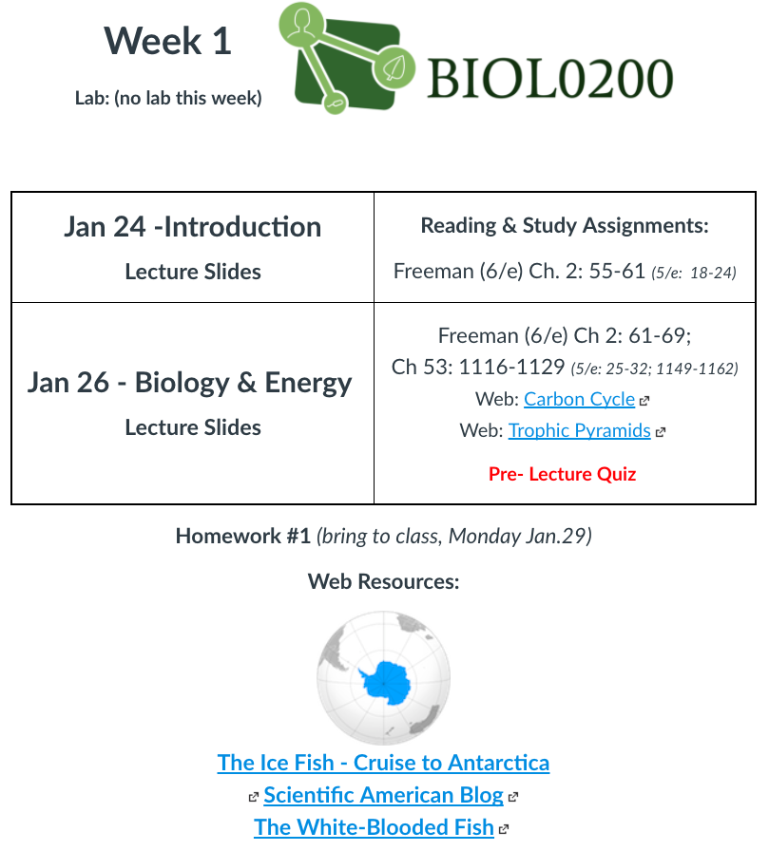
Each Week: Reading Assignments on Canvas
Textbook Pages
Pre-Lecture Quizzes
Homework
Additional Links

Slide 27
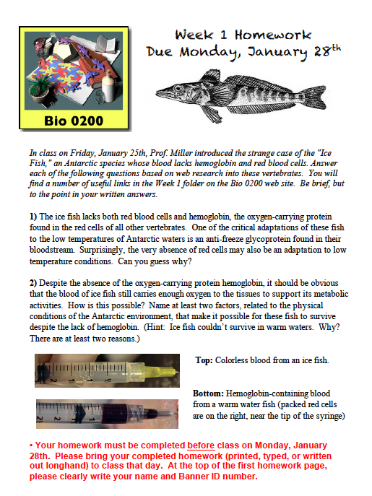
First Homework now on web site:
Due Monday (bring to class)

Slide 28
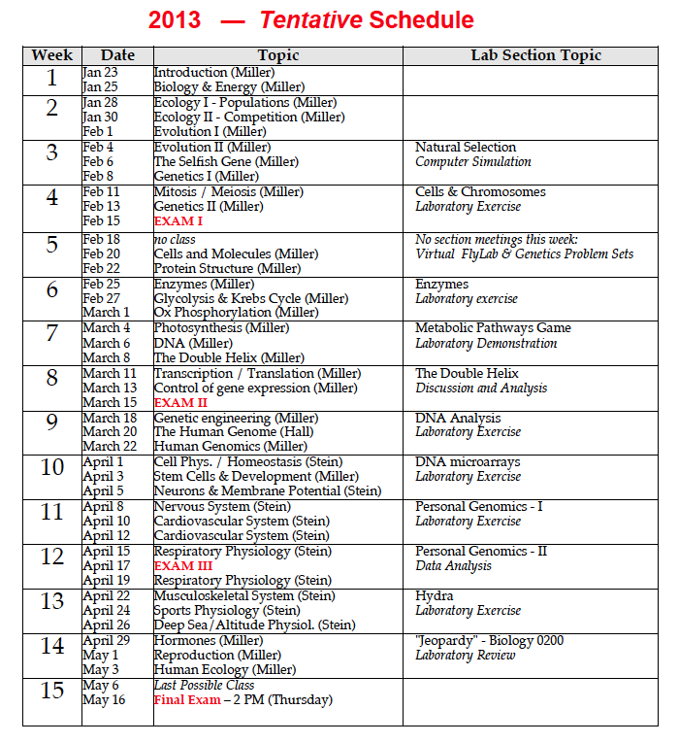
Biology 0200 - Lab & Lecture Schedule
Exams:
Feb 15
Mar 15
Apr 17
May 16 (Final)

Slide 30
Please come to your assigned Exam room
Lecture Videos (except Feb 8)
Exam Info Page:
Feb 8 (Genetics)

Slide 31
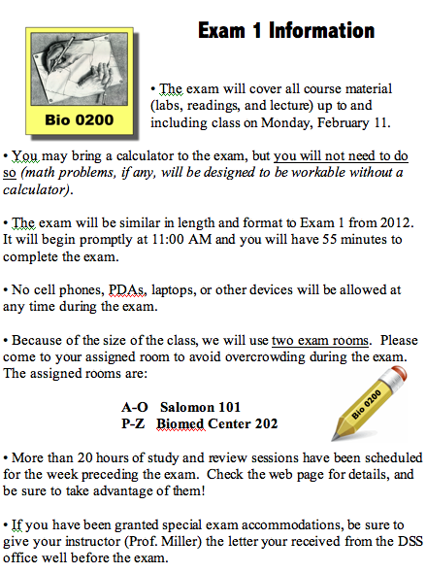
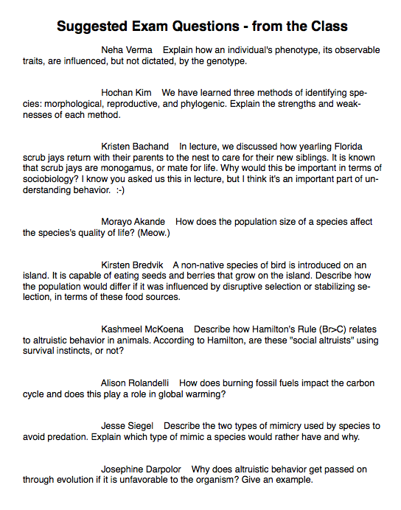
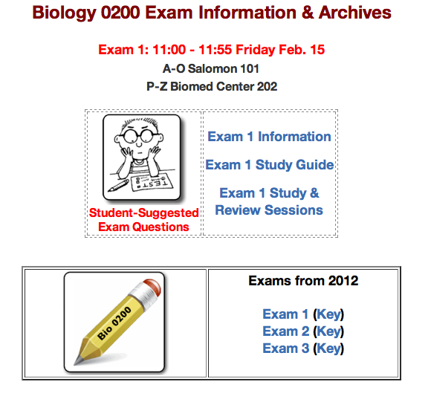
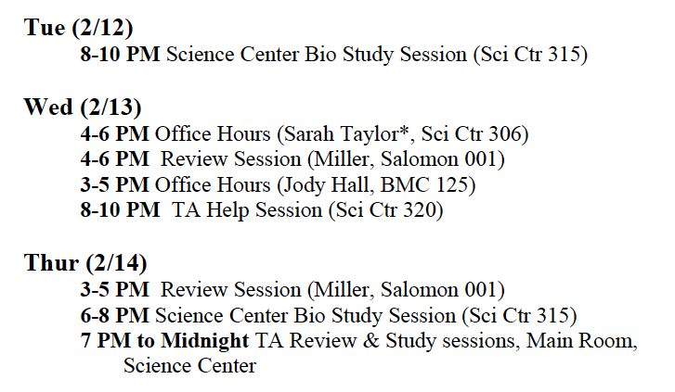
Check Exam Page for:
What’s Covered?
What’s Allowed?
Length? Format? Student Questions.

Slide 32
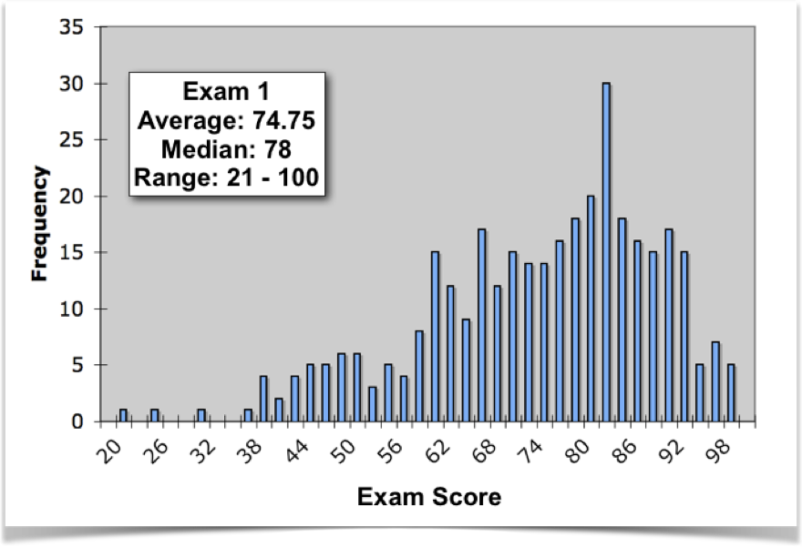
Despite good HS preparation and course organization, a significant segment of the class (~ 9%) still fails.

Slide 33
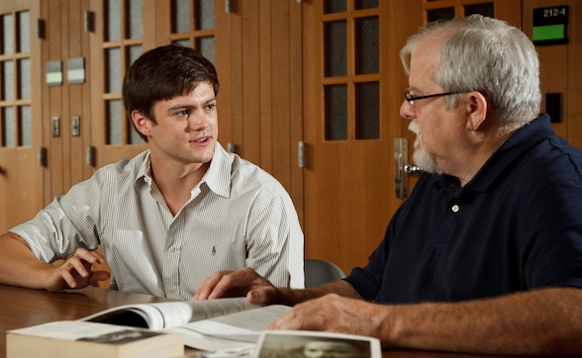
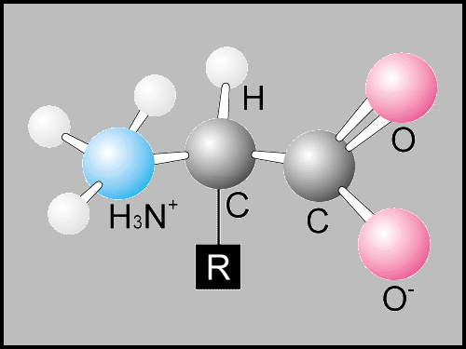
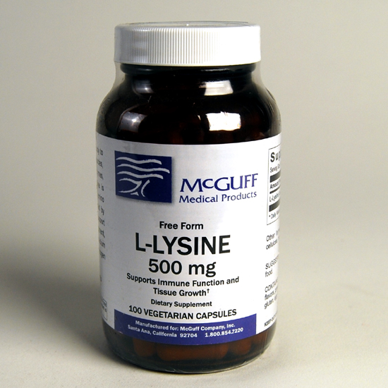
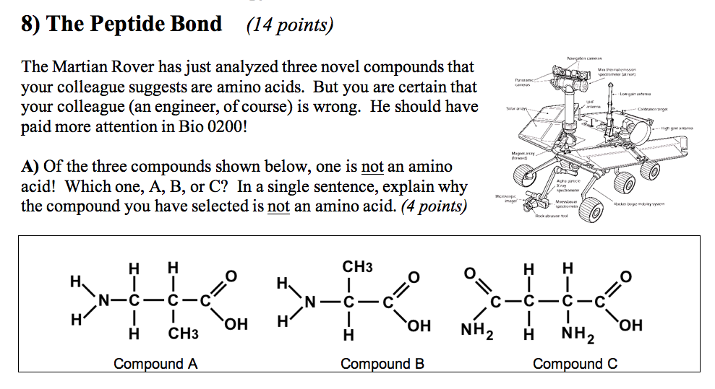
“But you never gave us an answer for that kind of question.”

Slide 34
“How were we supposed to know about wine-making?”

Slide 35
The Answer: “I gave you every tool and every piece of information you needed to solve those problems. What I expected was that you would be able to put them together to provide an answer!”

Slide 36
What are the Reasons for failure?
Common denominators among struggling students:
• Lack of interest / engagement with material.
• Missing or late homework assignments.
• Did not use Prof’s office hours.
• Has never emailed Prof or TA.
• Has not signed up for course tutorial.
• Is unaware of Science Center study groups.
• Is ashamed / embarrassed by own performance.
The one thing I really never see?
A student who’s not “smart” enough.

Slide 37
So what’s need to ensure readiness in science before a student walks through those gates?

Slide 38
Reading (and writing)
Yes, I’m talking about science students!
And the students who do best are the ones who read outside of science for pleasure!

Slide 39
Basic science literacy is essential.
But I really do mean basic!
Chemistry, Physics, Earth Science, Biology.
It’s great to know more. But most college science courses are going to start with the basics (and move quickly).

Slide 40
Math skills
Calculus would be nice
But algebra is essential!

Slide 41
We can model what happens in the later phase by assuming that the system has a carrying capacity (K) ...
K
K - N K
[ ]
I = ro N
it represents the proportion of unexploited resources in K.
What does this proportion actually represent?
K - N K
ΔN
[ ]
= rmax N
Δt

Slide 44
The ability (and willingness) to work independently is essential
College kids are largely left alone

Slide 45
Motivation and Drive
This is where HS science courses are key, by establishing an interest in science!

Slide 46
Essential: the willingness to admit when you just don’t understand.
All students are proud.
Sometimes too much for their own good.
Humility matters!

Slide 47
Readiness for College Science?
Reading skills
Math proficiency
Basic Science background
Independence
Motivation
Humility

Slide 48
If these elements are present, all is possible.
Reading skills
Math proficiency
Basic Science background
Independence
Motivation
Humility

Slide 49
How to Achieve such Readiness?
With real, hands-on science.
With inquiry that uses the scientific method.
With an understanding of science as a process.
With constant challenges that expand and explore the world of science.

