Slide 1
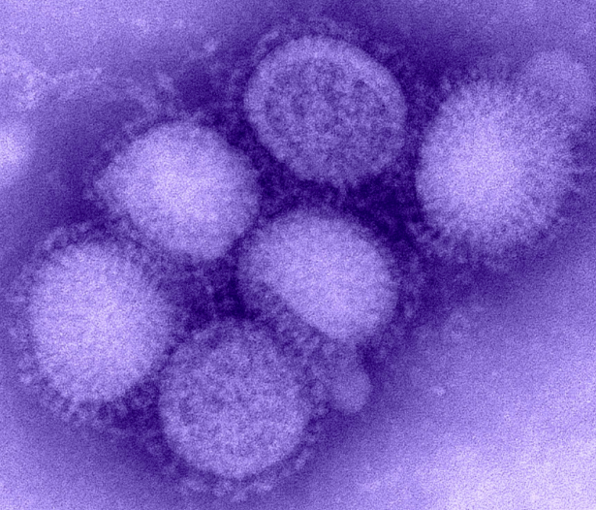
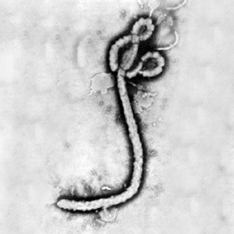
New and Emerging Infectious Diseases
Cross-Cutting Concepts and Case Studies
Ken Miller
Brown University
DSLCoP Meeting September 4, 2019

Slide 2
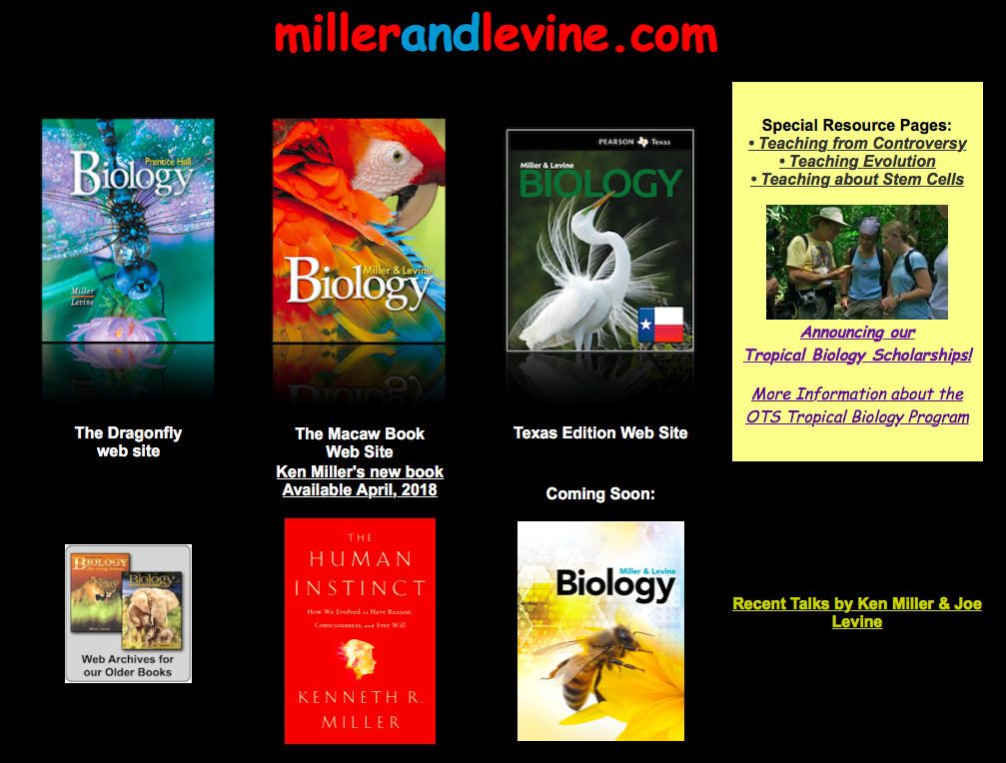
/calworkshops-2019

Slide 3
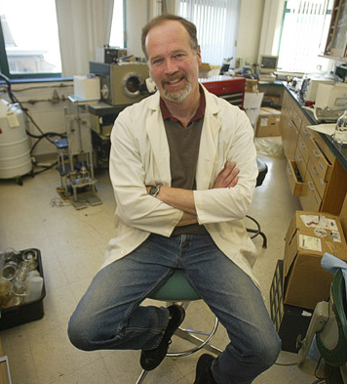
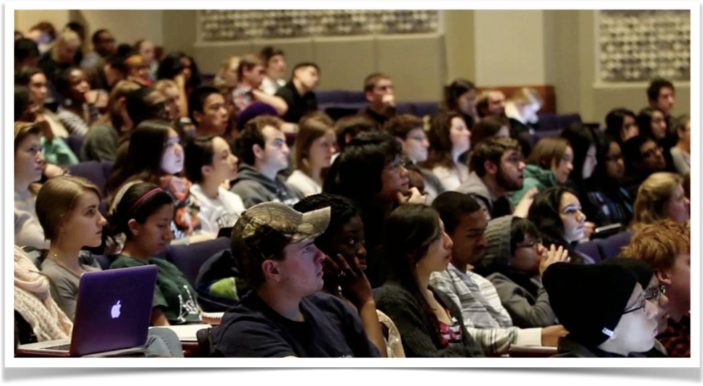
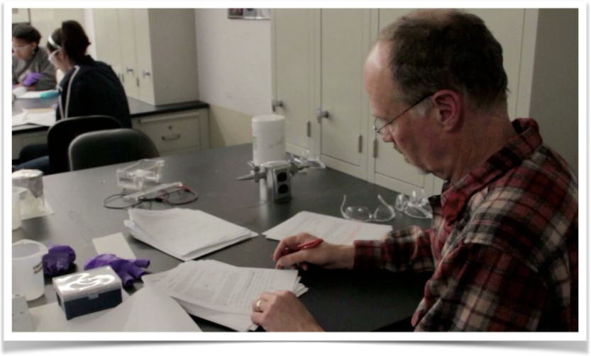
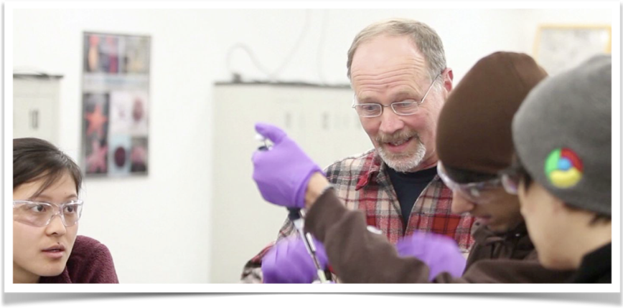

Slide 4
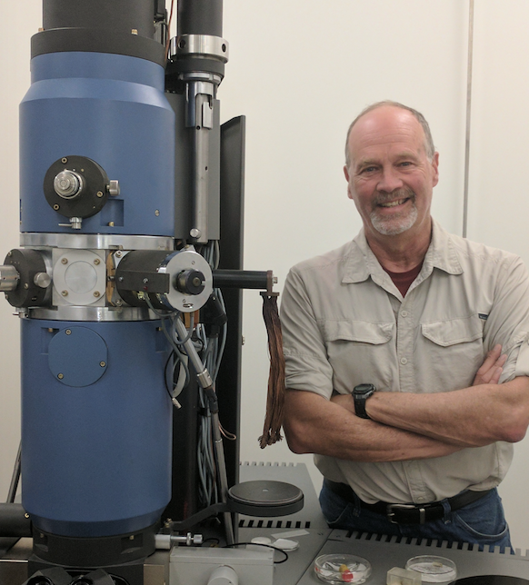
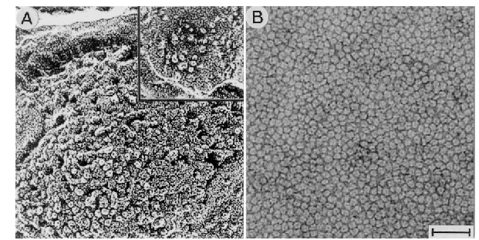
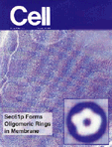
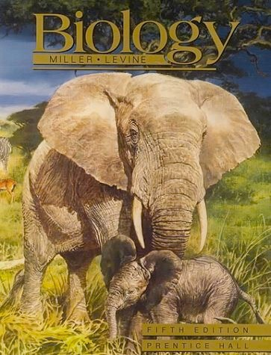
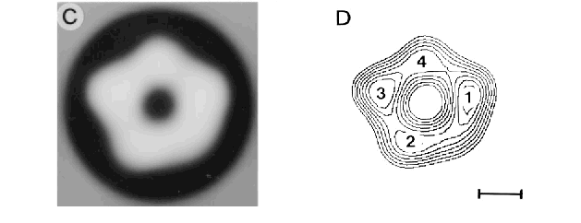
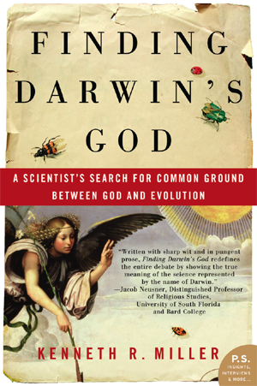
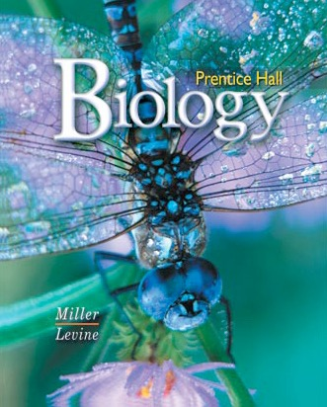
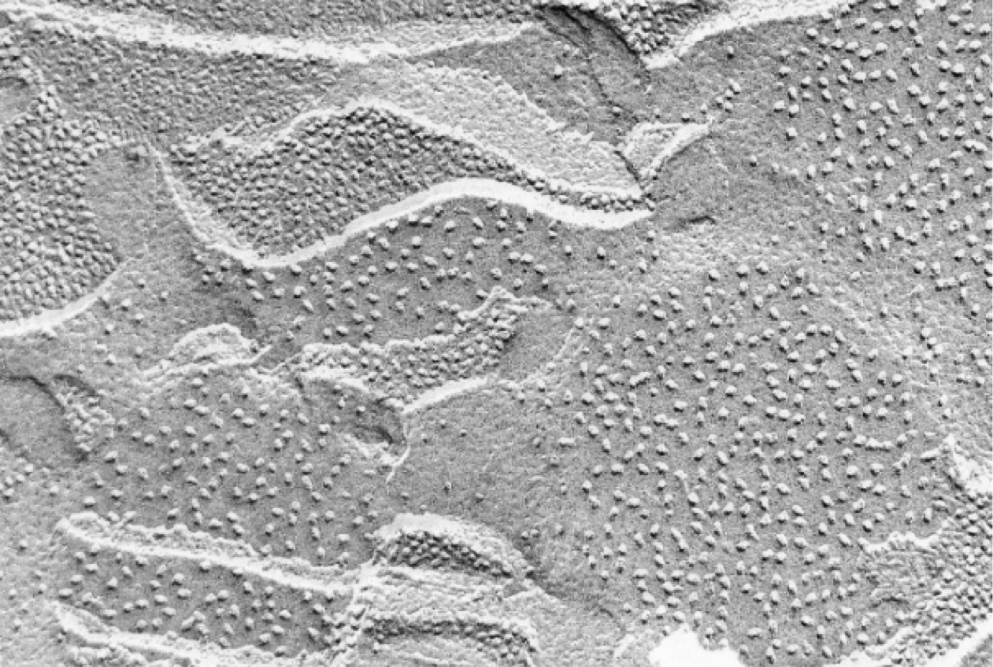
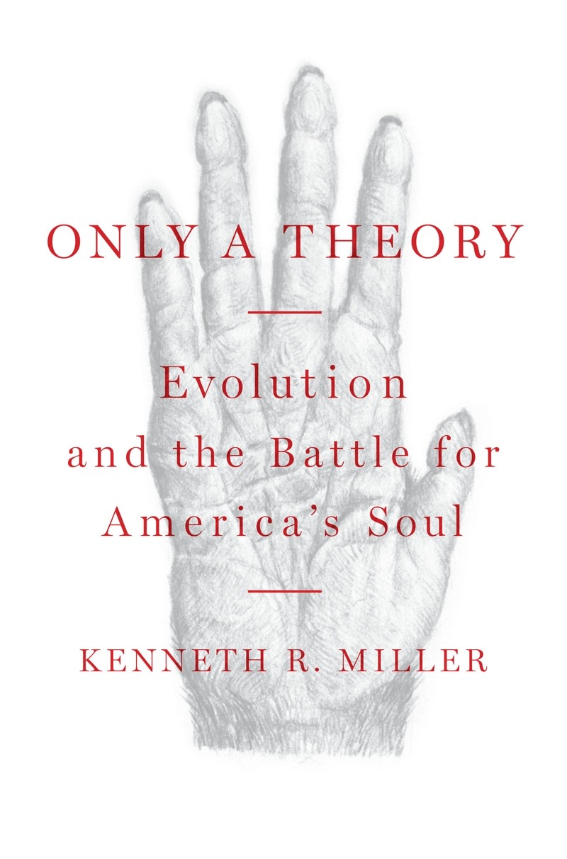
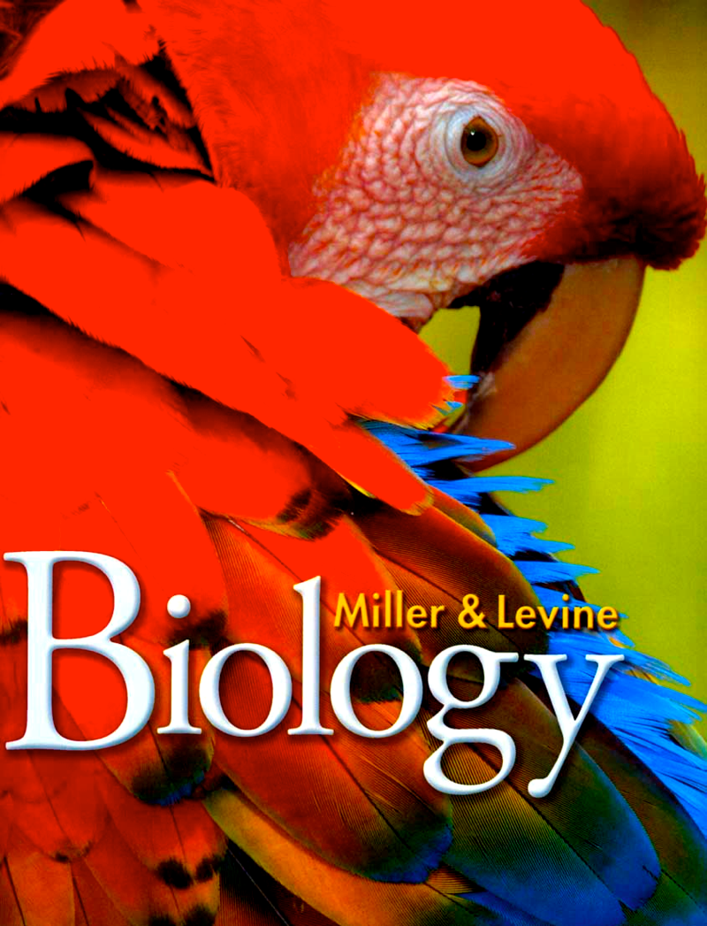
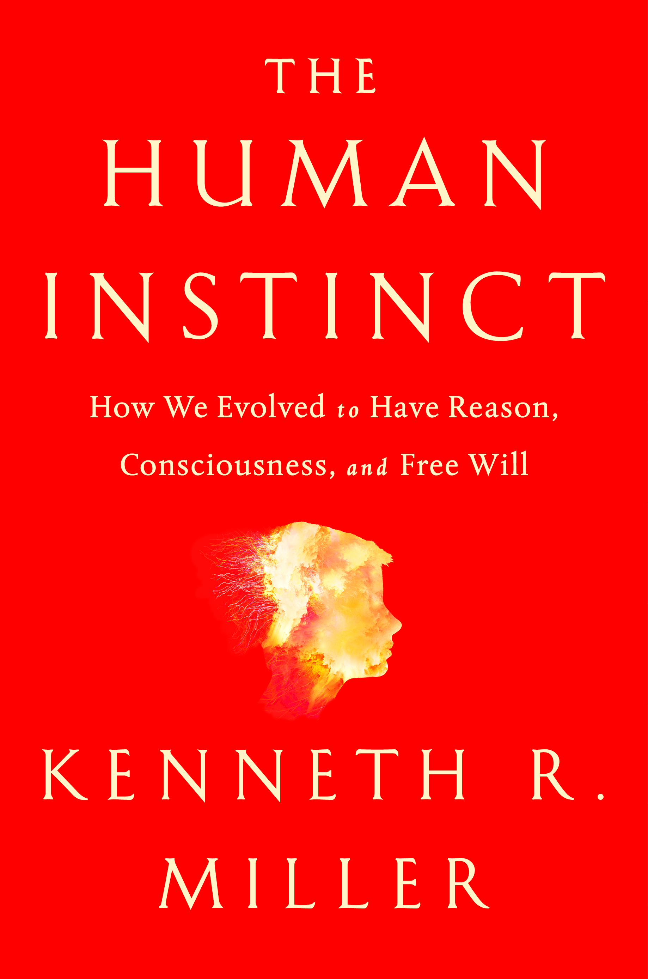
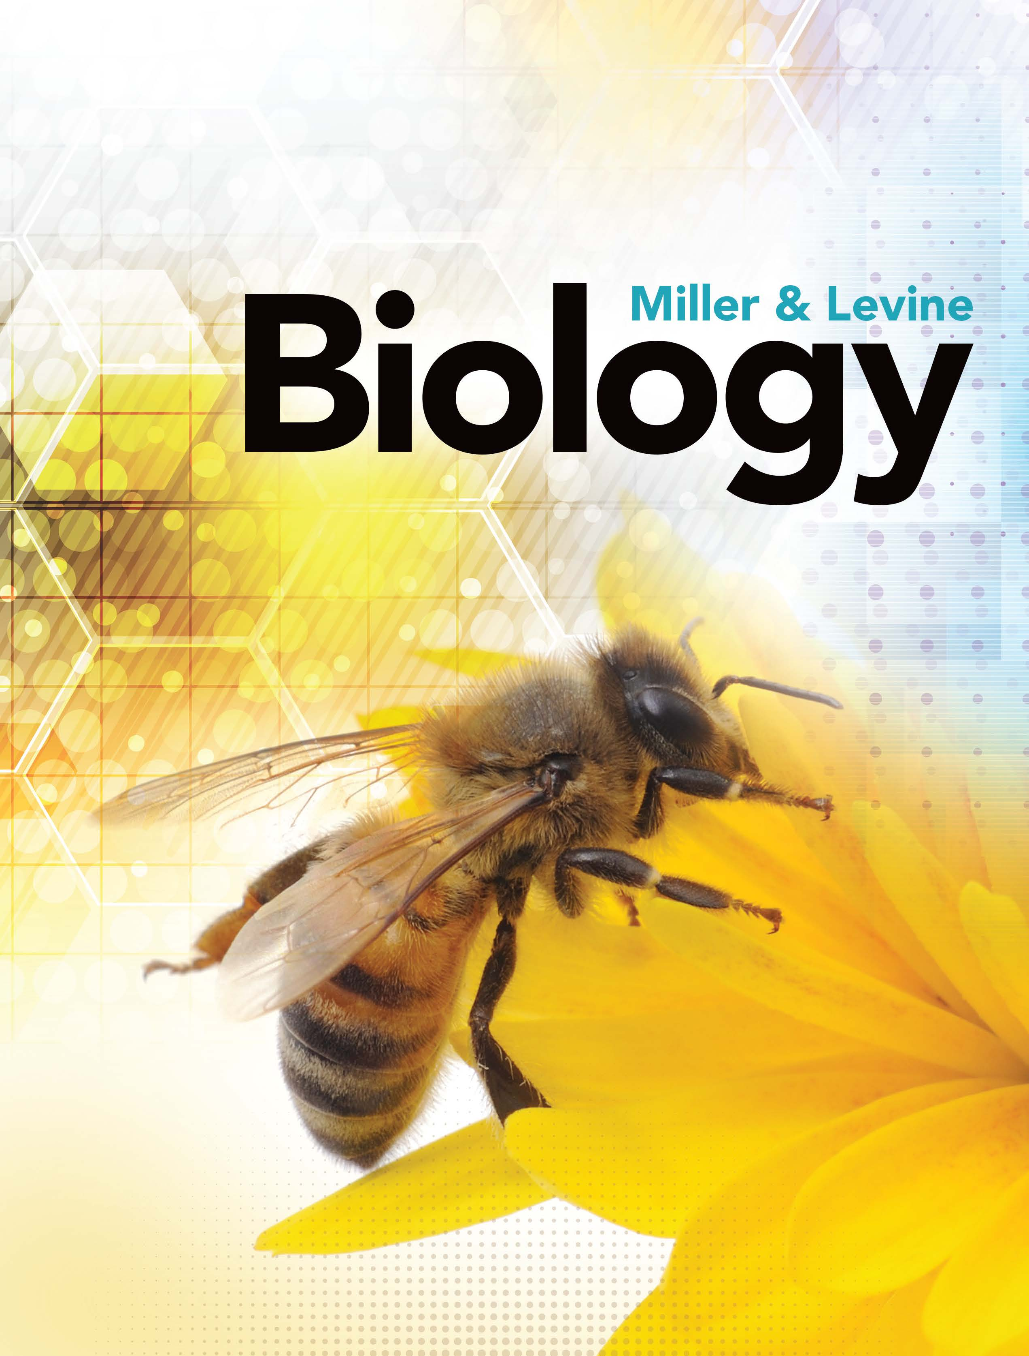
California

Slide 5
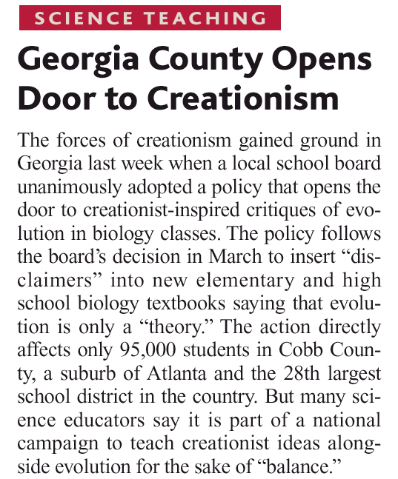
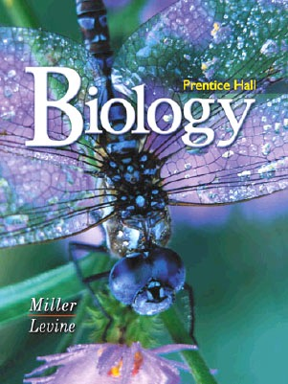
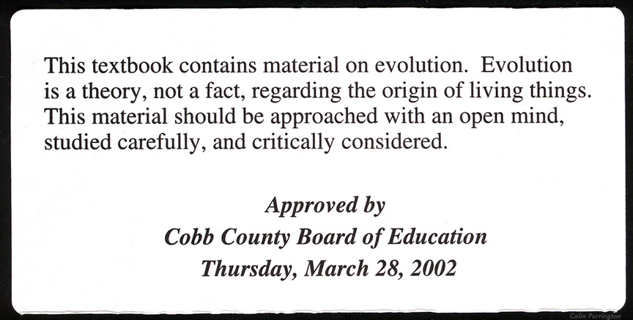
Cobb County, Georgia - 2004
Students must be “warned” about Evolution in textbooks.
An Accurate Disclaimer:
This textbook contains material on science. Science is built around theories, which are strongly supported by factual evidence. Everything in science should be approached with an open mind, studied carefully and critically considered.

Slide 6
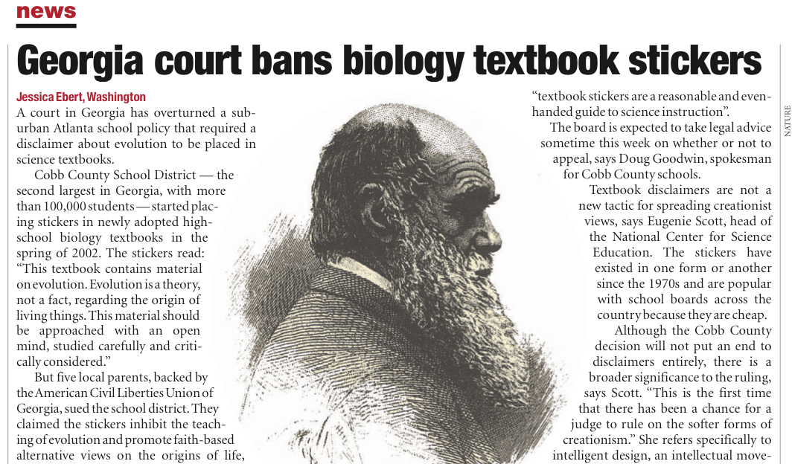
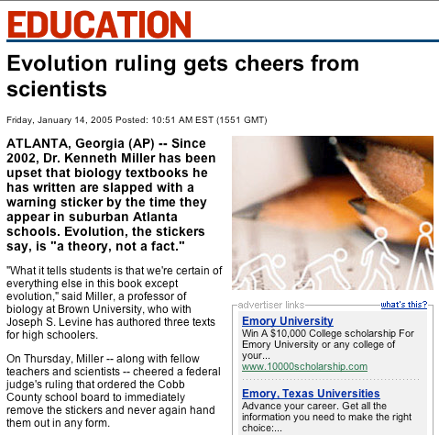
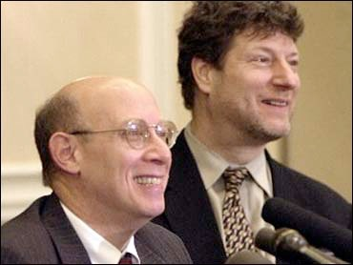
\
Jeff Selman

Slide 7
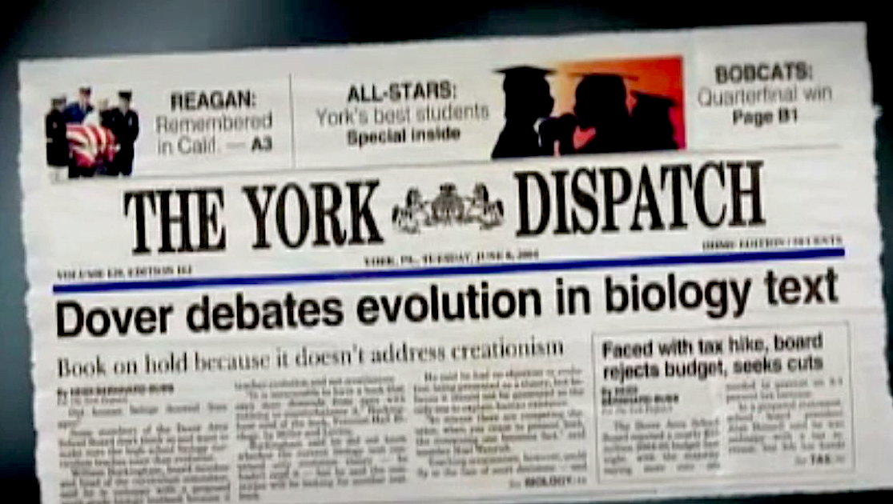
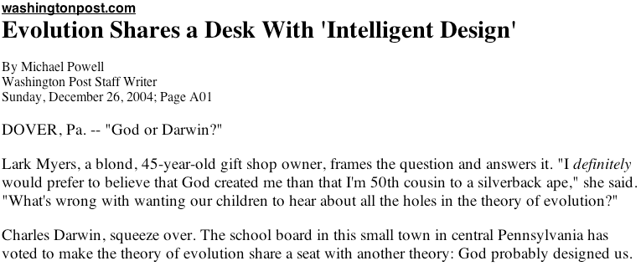
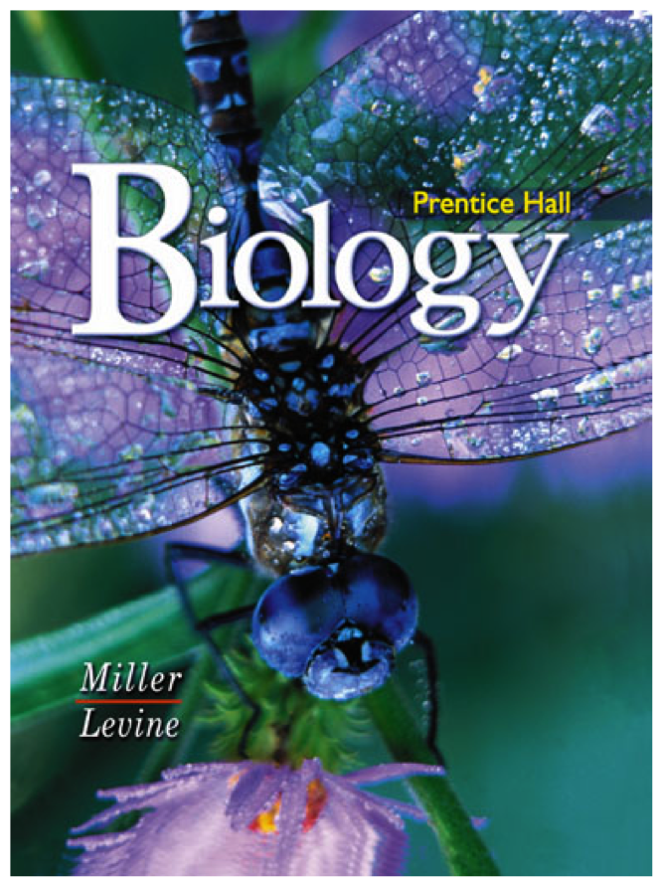
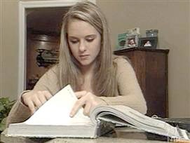
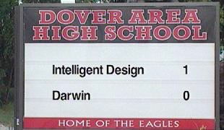
The conflict continues (2004): The Dover (PA) school board votes for “intelligent design” lessons in biology classes.
Notes:
Current battle — Dover, PA

Slide 8
Judgment Day
PBS - November 13, 2007

Slide 9
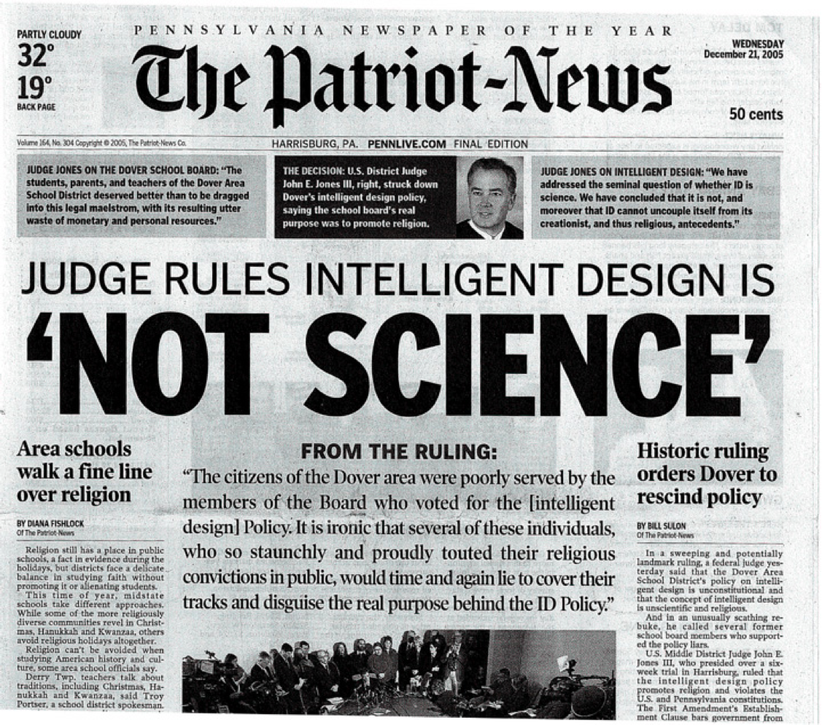
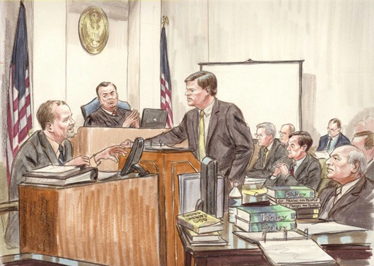
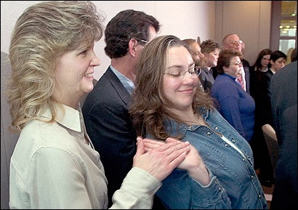
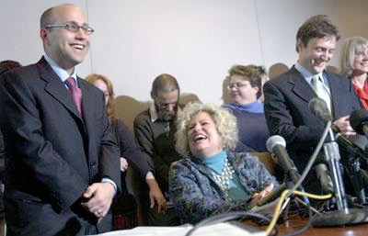
December 20, 2005 Decision Announced

Slide 10
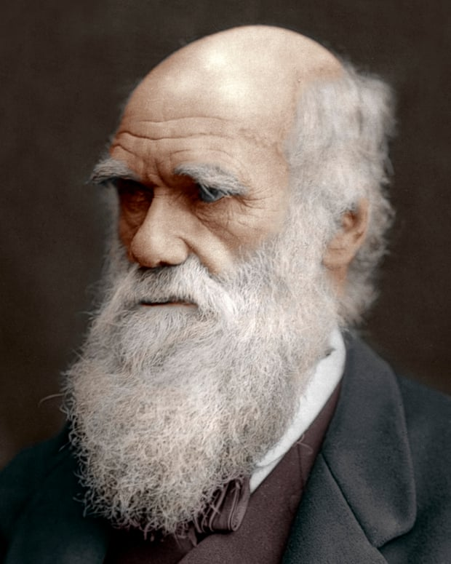
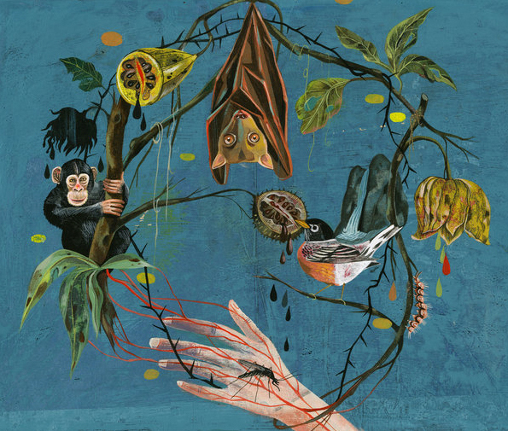
What does Evolution have to do with Infectious Disease?

Slide 11
Why teach about infectious diseases?
1. Because diseases have always been drivers of change in human history
2. The impact of past epidemics on society isn’t widely known. (It will be new to students).
3. They make GREAT narratives for teaching adolescents (blood, death, suffering etc.)

Slide 12
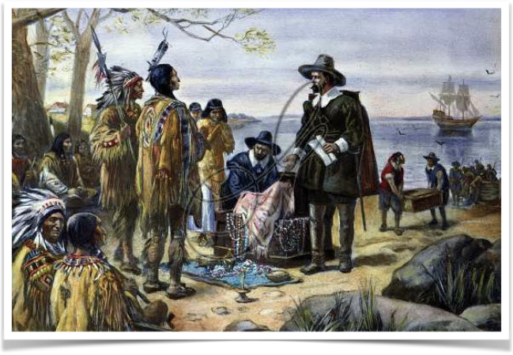
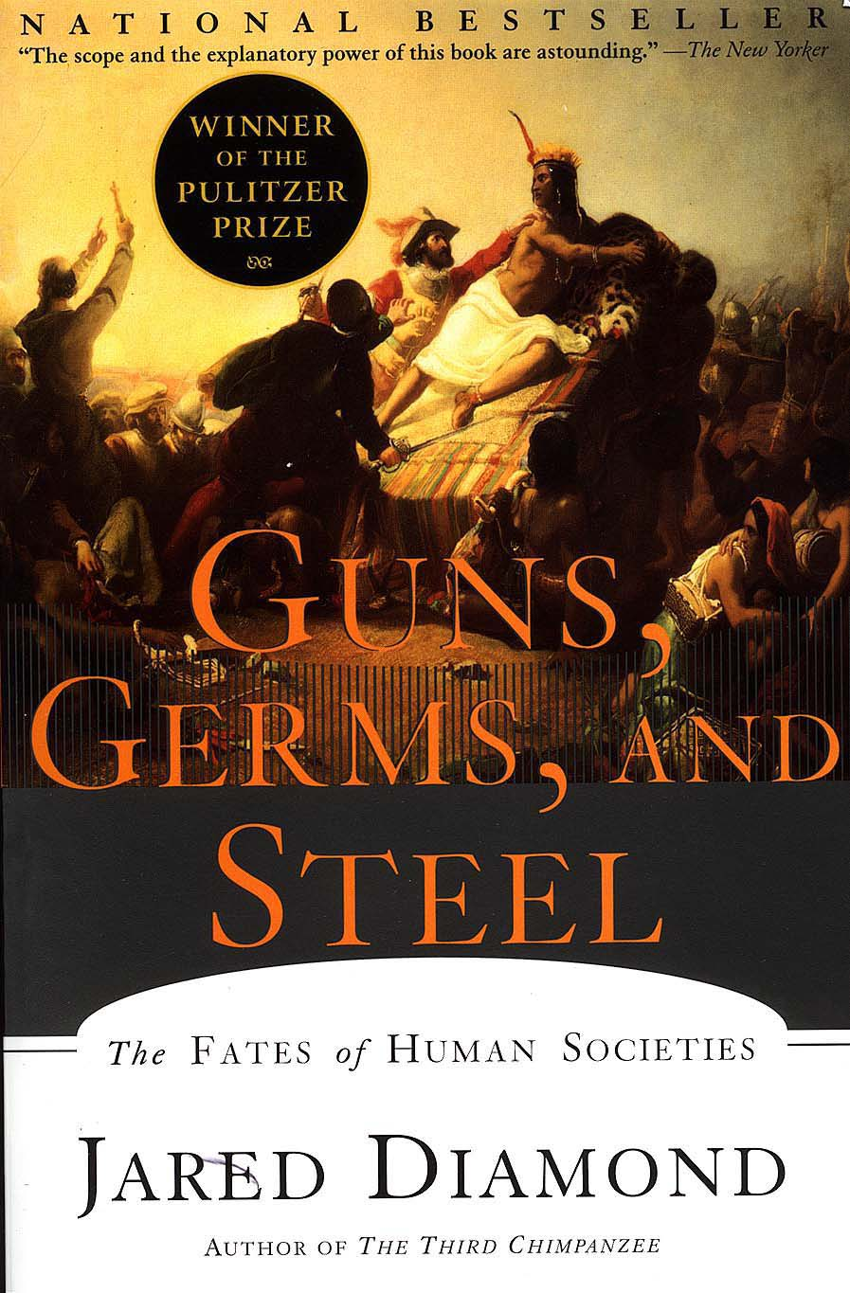
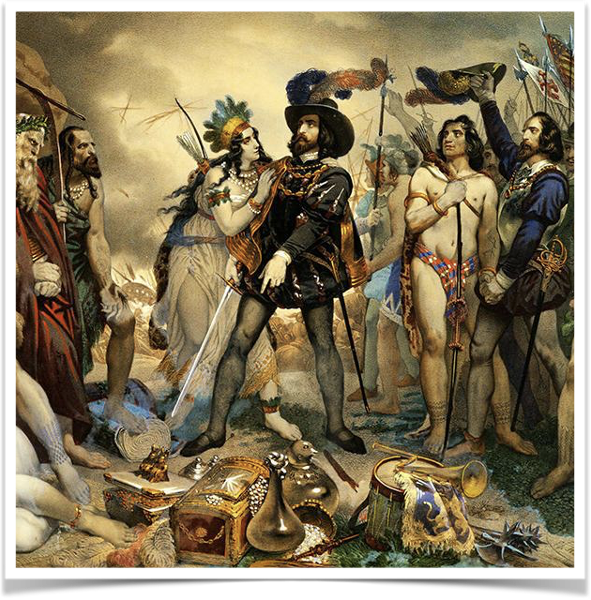
Diseases have changed History

Slide 13
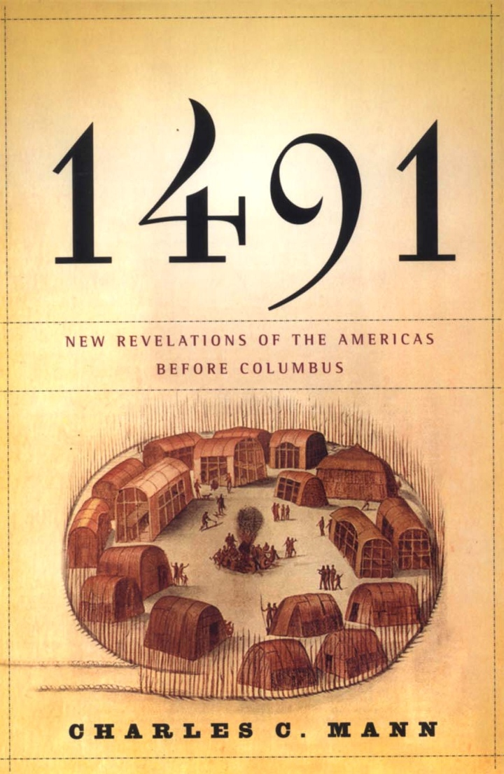
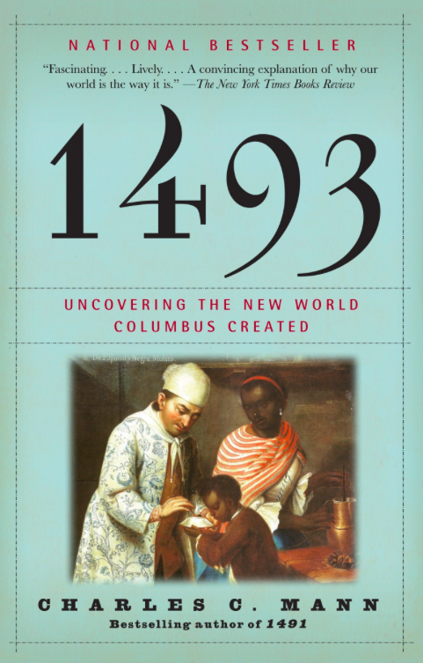

Slide 14
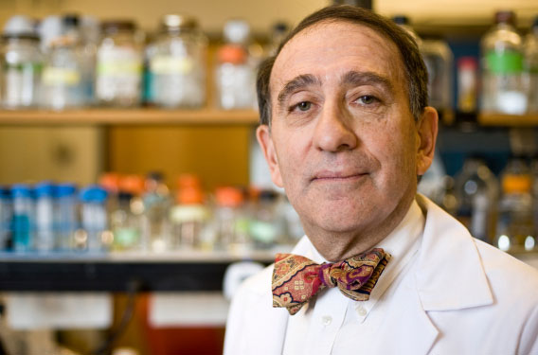
4. Narratives about infectious diseases show that EVOLUTION MATTERS to medicine and biomedical research.
“Medicine and public health would be much better off if medical students were taught as much about Darwin as they are about Pasteur.”
Dr. Stuart Levy, Tufts University School of Medicine

Slide 15
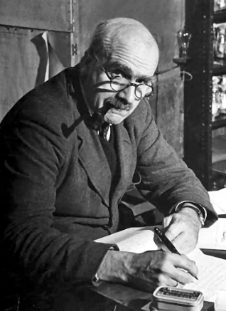
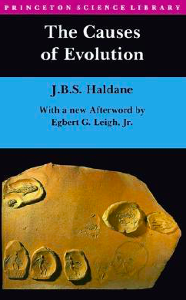
Infectious Diseases are Major Drivers of Evolutionary Change
Disease
Food & Water
Target Species
JBS Haldane
Physical Environment
Predators

Slide 16
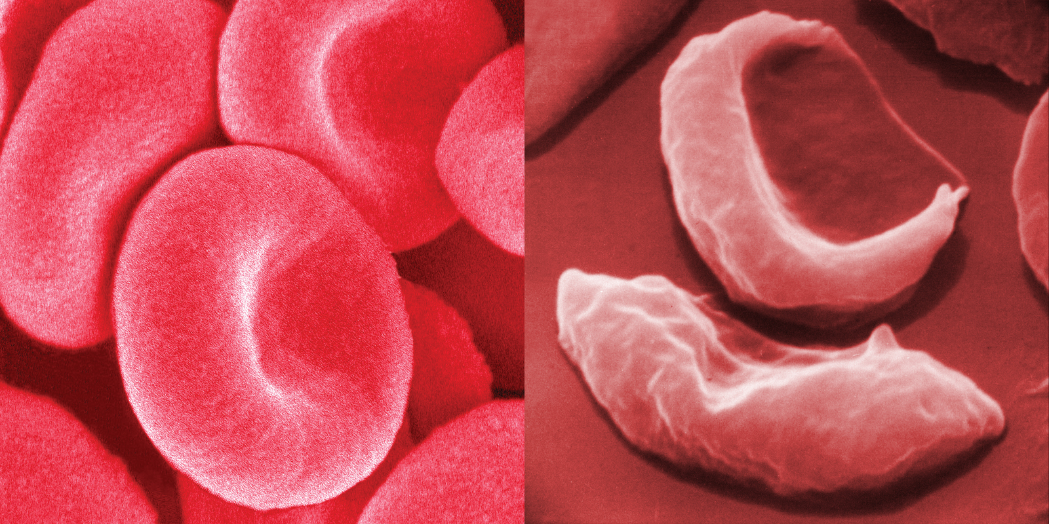
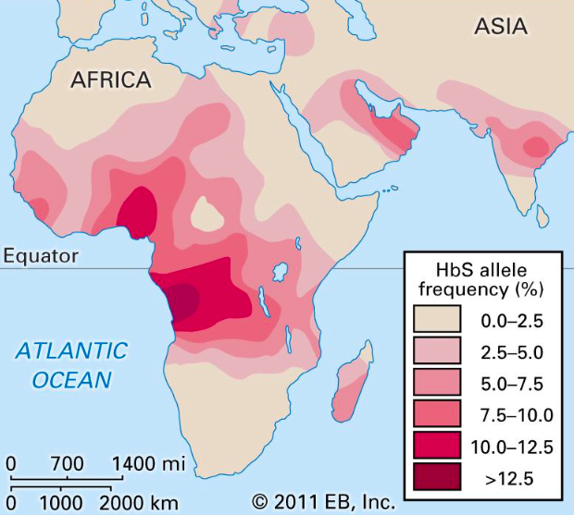
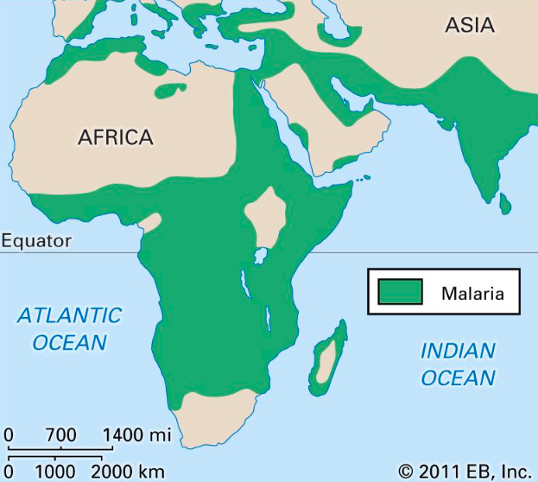
Including Human Disease
Example: Sickle Cell Anemia

Slide 17
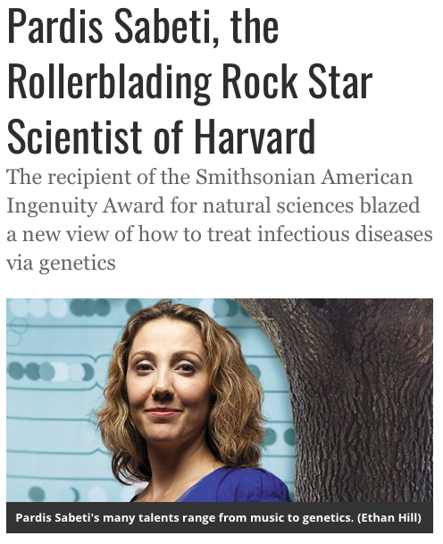
And they provide remarkable examples of Science in Action
Pardis Sabeta: Lead Singer of the band “Thousand Days”

Slide 18
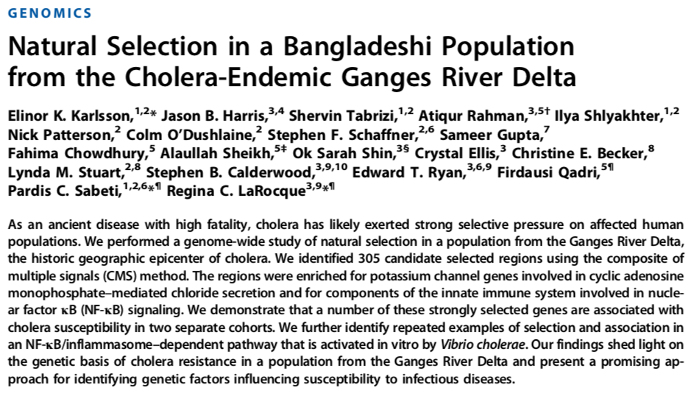
Lowest known incidence of Blood Type O
Strong Positive Selection for Cholera Resistance

Slide 19
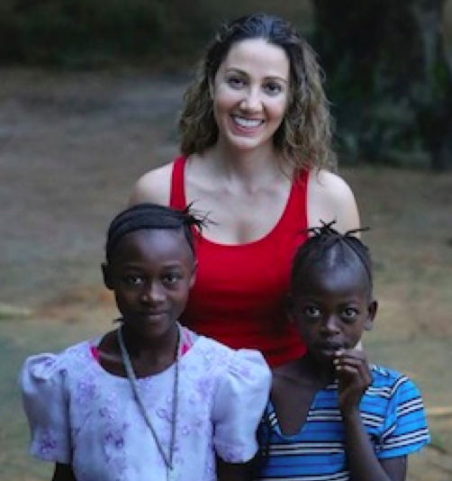
Her lab is now working on Lassa Fever virus

Slide 20
“Most patients are infected by exposure to excreta from the rodent Mastomys natalensis, which functions as a reservoir and maintains persistent infections.”

Slide 21
5. There are always new, emerging, and re-emerging diseases whose stories are new and exciting/scary.

Slide 22
What biological principles do these Emerging Viral Diseases demonstrate?
They combine Evolution and Ecology
Think: Cross-Cutting Concepts!

Slide 23
What do most “in the news” diseases have in common?
1. They are Zoonoses.
2. Their emergence and spread involve changes in human social ecology.
3. They affect humans due to changes in our interactions with local & global environments.
4. They remain dangerous to humans because they evolve!
5. Control requires scientifically-informed public health measures.

Slide 24
ZOONOSIS: A disease that can be transmitted from animals to humans - and often back again.
Examples?
Bubonic plague, rabies, hantavirus, Mad Cow, Bird/Swine Flu, West Nile Fever, Lyme Disease, SARS, Ebola, monkeypox, Nipah encephalitis, Lassa fever

Slide 26
1976:
A viral hemorrhagic fever is discovered in Zaire

Slide 27
Ebola virion
Ebola is a classic zoonotic disease
We know its evolutionary relationship to other viruses
We know how it spreads
Fruit bats and rodents are reservoirs for the disease.

Slide 29
6. The emergence and spread of Zoonotic diseases involve changes in human social ecology.

Slide 30
“Human social ecology” includes population density, where we live, the way we travel, and the way we produce our food.
These factors alter interactions among human populations, domestic animal populations, and wild animal populations.

Slide 31
The history of H.I.V. is a prime example.
Where did this deadly virus come from?
You’ve probably heard “Africa” - but how and why?

Slide 32
How would an evolutionary biologist search for the origin of a virus that manipulates human immune systems with deadly skill?
By looking for similar viruses in our closest living relatives: primates in Africa.
What they found was fascinating
Many African primates are infected by similar retroviruses.
But how could these viruses have jumped to humans?

Slide 33
“Bushmeat” trade in these regions brought human hunters into direct contact with simian retroviruses.

Slide 34
The “bushmeat hypothesis” is interesting … But is it supported by data?
Science & Engineering Practices: Developing Models Carrying Out Investigations Engaging in Argument from Evidence
For years, transmission of retroviruses from apes to humans was known only in laboratory and zoo environments.
But then …

Slide 35
Investigation Result:
Simian Retroviruses detected in Bushmeat Hunters
Hypothesis Building:
Could some of these be related to HIV?

Slide 37
The evolutionary tree shows that:
- HIV-1 and HIV-2 originate from SIVs in different primate species
- HIV-1 strains are closely related to SIVcpz/s, from the chimpanzee subspecies Pan troglodytes troglodytes
- HIV-2 strains are closely related to SIVsmm, from sooty mangabey monkeys (Cercocebus atys).
- HIV-1 groups M, N and O must have originated from three separate chimpanzee-to-human transmissions, because these lineages are interspersed among the SIVcpz/s branches.

Slide 38
7. Pathogens are dangerous because they are constantly evolving!

Slide 39
Influenza: “The Flu”

Slide 40
Hemagglutinin (H)
Binds to receptors on host cell surfaces, “tricking” those cells into taking the virus inside.

Slide 41
Neuraminidase (N)
Helps newly-formed virus particles leave the host cell.

Slide 42
Viral genome: 10 genes carried on 8 separate strands of RNA.

Slide 43
How do flu viruses make us sick?
Hemagglutinin proteins attach to cell, allowing viral RNA to enter.
New virus particles exit cell via action of Neuraminidase.
Viral RNA replicates, produces mRNA for new coat proteins.

Slide 44
16 known forms of Hemagglutinin
9 known forms of Neuraminidase
2009: Swine Flu H1 / N1 2011: Bird Flu H5 / N1 2013: “Avian” Flu H7 / N9 2019: H1 / N1 and H3 / N2 (more virulent)

Slide 45
H and N are viral surface proteins that act as antigens to trigger our immune response.
Viruses are therefore under pressure from natural selection to evolve new forms and combinations of H & N that immune systems CAN’T recognize.
Meaning: Viruses are locked into an evolutionary “arms race” with our immune systems.

Slide 46
“Nuisance” strains result from minor mutations in flu genes that produce small changes in viral antigens. The illness these “antigenic drift” mutants cause is annoying, but not usually life-threatening.
But major genetic change can produce major changes in antigens. These “antigenic shifts” can produce lethal strains that cause global epidemics, also called pandemics ...
...like the Pandemic of 1918.

Slide 47
50 million deaths worldwide. 675,000 deaths in the US.
Could this happen again?

Slide 49
But why is genetic variation that evolves in flu strains infecting other species important to humans?
Because of something we could call ...
“viral sex”

Slide 50
Viral strain 1
Viral strain 2
Two viral strains infect the same host cell at the same time
Host Cell

Slide 51
Viral strain 1
Viral strain 2
Host Cell
RNA from both strains is injected into the host cell and replicated

Slide 52
As new viral particles are assembled, RNA strands from the two strains sort independently, forming new combinations of genes

Slide 53
Some newly-formed viruses carry new combinations of genes from both parent strains

Slide 54
Sometimes, these recombinant viruses carry new genes combinations that are very good for them, and very dangerous for us.

Slide 55
Bird Flu (2013) was produced by antigenic shifts (viral sex) involving at least 4 strains of influenza.
H7N3
H7N9
Novel (H7Np) Human Influenza
H9N2
H9N2

Slide 56
Combine “viral sex” with viral strains that have evolved in different parts of the zoonosis ... and we could be in serious trouble.

Slide 57
8. Disease control requires scientifically-informed public health measures - such as vaccination.
Seems like a no-brainer. Right?

Slide 58
Unfortunately, a powerful anti-vaccine movement is active in the US.

Slide 59
This year may see the largest number of measles cases in three decades.

Slide 60
Conservatives associate vaccination programs with the Big Government.
Limbaugh on the H1N1 vaccine:
“Screw you, Ms. Sebelius! I am not going to take it, precisely because you're now telling me I must. It's not your role, it's not your responsibility, and you do not have that power. I don't want to take your vaccine. I don't get flu shots.”

Slide 61
Liberals associate vaccines with Big-Business Pharmaceutical Companies.

Slide 62
The facts?
• Vaccinations save lives
• The only supposed “link” between vaccines and autism was a fraud.

Slide 63
Disease as phenomenon
Case Studies in Science Practices and Cross Cutting Concepts

Slide 64
A Case Study: Cholera and John Snow
No, not this Jon Snow
This one: Dr. John Snow
Vibrio cholerae

Slide 65
1854: A Cholera epidemic ravages central London
More than 600 people die in just a few weeks

Slide 66
Cholera can kill in a matter of hours

Slide 67
It was thought to be caused by bad air.

Slide 68
Unafraid of the “bad air,” John Snow walked the affected districts from house and counted the number of victims at each address:

Slide 69
Snow assembled a map of Cholera victims in central London

Slide 70
Snow assembled a detailed map of the victims in central London

Slide 71
Determine the Source of the London Epidemic
Analyze the mechanism and selective advantage of the Cholera bacterium

Slide 72
Asking Questions
Carrying out an Investigation
Constructing and Testing a Model
Argument from Evidence
Cause & Effect: Mechanism & Explanation
Variation of Traits
Natural Selection & Adaptation
Ecosystem Dynamics

Slide 73
Finally: Explain why this handle-less pump remains as a memorial to the epidemic of 1854.

Slide 74
millerandlevine.com/calworkshops-2019
California
ken.miller@brown.edu
401-863-3410 Twitter: @kennethrmiller

